Slide 1
Household Modeling Prototype

Slide 2
Outline
Example Scenario
Household Demographics – some kids, adults
Human Migration
Work Node
Family Trips vs Men Only
Vector Migration
Migration Files
VectorHabitat
LarvalHabitatMultiplier
Food Modifier
Stay Put Modifier
Interventions
Target Near By Households
Trigger Individual Migration
Target Residents Only
Multiple Villages
Clinics
New Households

Slide 3
5x5 Grid of Households
Humans use local migration to adjacent nodes. For example, people in Node 4 can go to 3, 5, 10, 9, & 8. People in Node 1 can only go to 2 & 6.
5
People: 15
Vectors: 50
10
People: 10
Vectors: 50
15
People: 5
Vectors: 100
20
People: 10
Vectors: 100
25
People: 1
Vectors: 100
4
People: 5
Vectors: 50
9
People: 10
Vectors: 100
14
People: 0
Vectors: 100
19
People: 10
Vectors: 100
24
People: 10
Vectors: 100
No Human migration to nodes with zero people except Work Node. That is, no people will go to nodes 7, 14, 16, 21, & 22.
41-400
35-450
46-600
30-900
25- 1200
0-1000
177-4550
3
People: 1
Vectors: 100
8
People: 10
Vectors: 100
13
People: 10
Vectors: 100
18
People: 10
Vectors: 100
23
People: 15
Vectors: 200
0.005 deg
~1813 ft
~0.553 km
2
People: 10
Vectors: 100
7
People: 0
Vectors: 100
12
People: 15
Vectors: 100
17
People: 5
Vectors: 200
22
People: 0
Vectors: 400
Work Node
1
People: 5
Vectors: 100
6
People: 10
Vectors: 100
11
People: 10
Vectors: 200
16
People: 0
Vectors: 400
21
People: 0
Vectors: 400
26
People: 0
Vectors: 1000

Slide 4
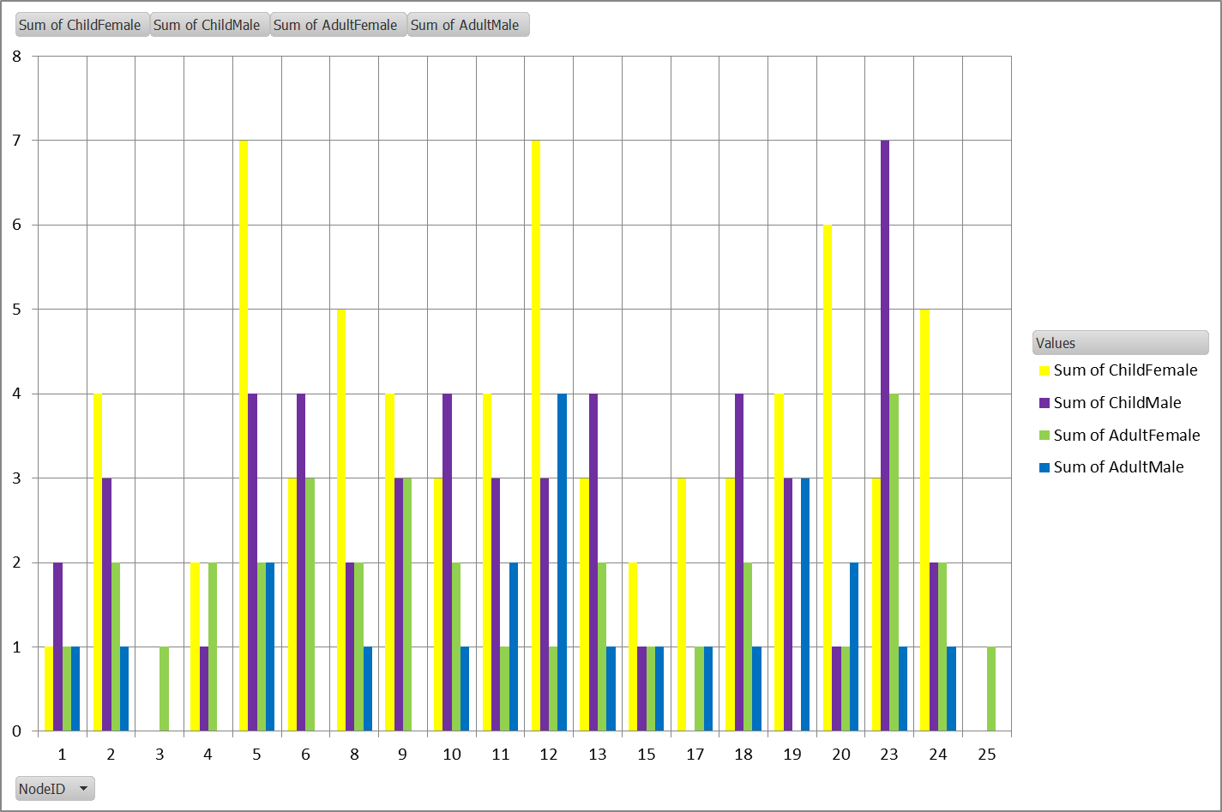
Demographics Distribution of Gender & Adults

Slide 5
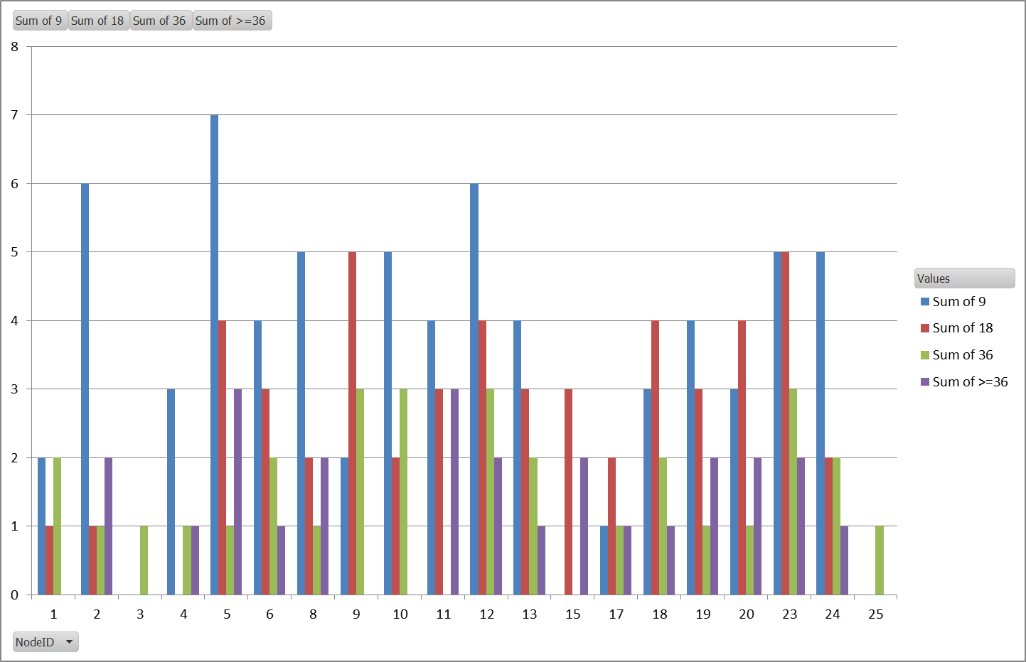
Demographics Age Distribution

Slide 6
Human Migration
Migration_Model = FIXED_RATE_MIGRATION
Migration_Pattern = SINGLE_ROUND_TRIPS
Local
Adjacent nodes are those nodes that have people at initialization and “touch” the node of interest
Rate = 1/num_adj_nodes/20
MigrationHeterogeneityDistribution = 0.25
Local_Migration_Roundtrip_Duration = 1.0
Local_Migration_Roundtrip_Probability = 1.0
Regional
Non-adjacent nodes in the village and not the Work Node
Rate = 1 / num_nodes / 10
Regional_Migration_Roundtrip_Duration = 1.0
Regional_Migration_Roundtrip_Probability = 1.0
Sea / Work Node
All nodes with people can go to the Work Node
Rate = 1 / 100
Sea_Migration_Roundtrip_Duration = 100.0
Sea_Migration_Roundtrip_Probability = 1.0
Enable_Sea_Family_Migration = 1.0
Sea_Family_Migration_Probability = 1.0
MigrationDemograhicTypes – Adult_Male, Adult_Female, Child_Male, Child_Female
Sea_Demographics_Modifier_XXX – one for each type, impact probability that a person goes on trip to sea node

Slide 7
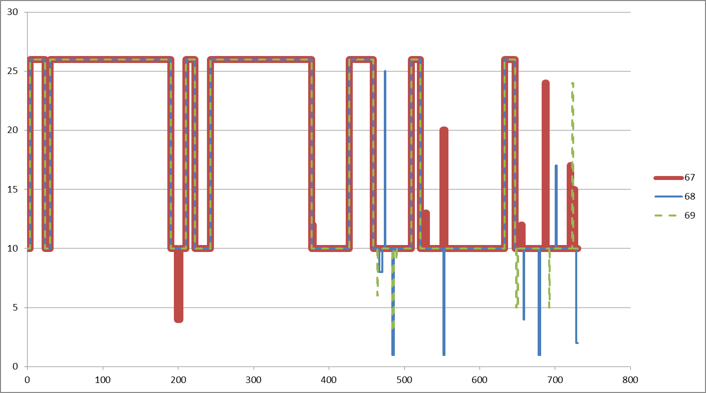
Family Trips

Slide 8
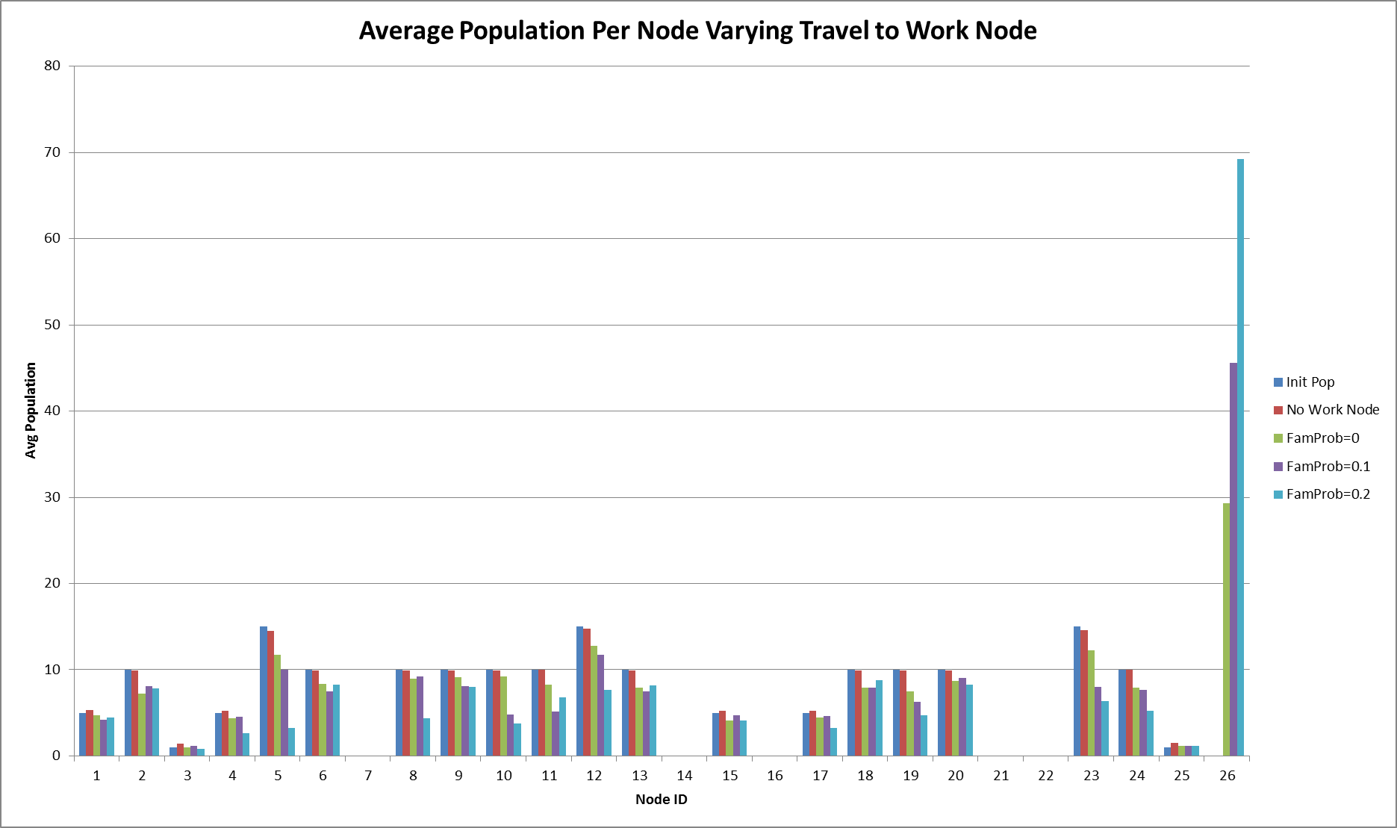
Sea_Family_Migration_Probability
As we increase the probability that a family will migrate, we see the Work Node (26) increase in population and the other nodes decrease.

Slide 9
Vector Migration Examples
5
10
15
20
25
4
9
14
19
24
Existing vector migration uses the human reachable nodes. If we don’t want people traveling to certain nodes but want the vectors to, then vectors need their own migration files.
3
8
13
18
23
2
7
12
17
22
1
6
11
16
21

Slide 10
Vector Migration
Enable_Vector_Migration = 1
Local
Enable_Vector_Migration_Local = 1
Vector_Migration_Filename_Local is new
x_Vector_Migration_Local is new
Regional
Enable_Vector_Migration_Regional = 1
Vector_Migration_Filename_Regional is new
x_Vector_Migration_Regional is new
Modifiers
Vector_Migration_Modifier_Equation
Vector_Migration_Food_Modifier
Vector_Migration_Habitat_Modifier
Vector_Migration_Stay_Put_Modifier
Other
Enable_Vector_Migration_Human
Enable_Vector_Migration_Wind
Enable_Vector_Mortality is new

Slide 11
Vector Habitat
No competition between species
Current parameters allow for control of the size of the habitat per node

Slide 12
Vector Habitats
The node technically owns the VectorHabitats, but each VectorPopulation has pointers to the ones it is using. Notice:
a node can have more than one habitat type;
VP’s use only the habitats they are associated with.
Hence, no competition for habitat.
The size of the habitat can be controlled for each habitat and species on each node. Notice:
x_Temporary_Larval_Habitat affects all habitats;
Required_Habitat_Factor controls the size per species and habitat type;
LarvalHabitatMultiplier (in the demographics) allows one to apply multiplier for each node and habitat type.
Hence, we do not need to change anything.
Node
VectorHabitats
VectorPopulations
TEMPORARY_RAINFALL
arabiensis
max_larval_capcity
= LarvalHabitatMultiplier[ vht ]
WATER_VEGETATION
funestus
TEMPORARY_RAINFALL
gambiae
HUMAN_POPULATION
When vectors migrate, they go to the VP of the same species. Hence, they will only be impacted by the habitat associated with that VP. No habitat competition.
* Required_Habitat_Factor[ species ][ vht ] * x_Temporary_Larval_Habitat
HUMAN_POPULATION just used to illustrate that a species can be associated with more than one habitat type.
Vector Migration
Node
“species” : { “Habitat_Type” : [ ] } controls what habitats are created for each VP. VP is responsible for creating the habitats. It just adds them to the Node.
VectorHabitats
VectorPopulations
HUMAN_POPULATION
TEMPORARY_RAINFALL
gambiae
max_larval_capcity
= LarvalHabitatMultiplier[ vht ]
WATER_VEGETATION
funestus
TEMPORARY_RAINFALL
arabiensis

Slide 13
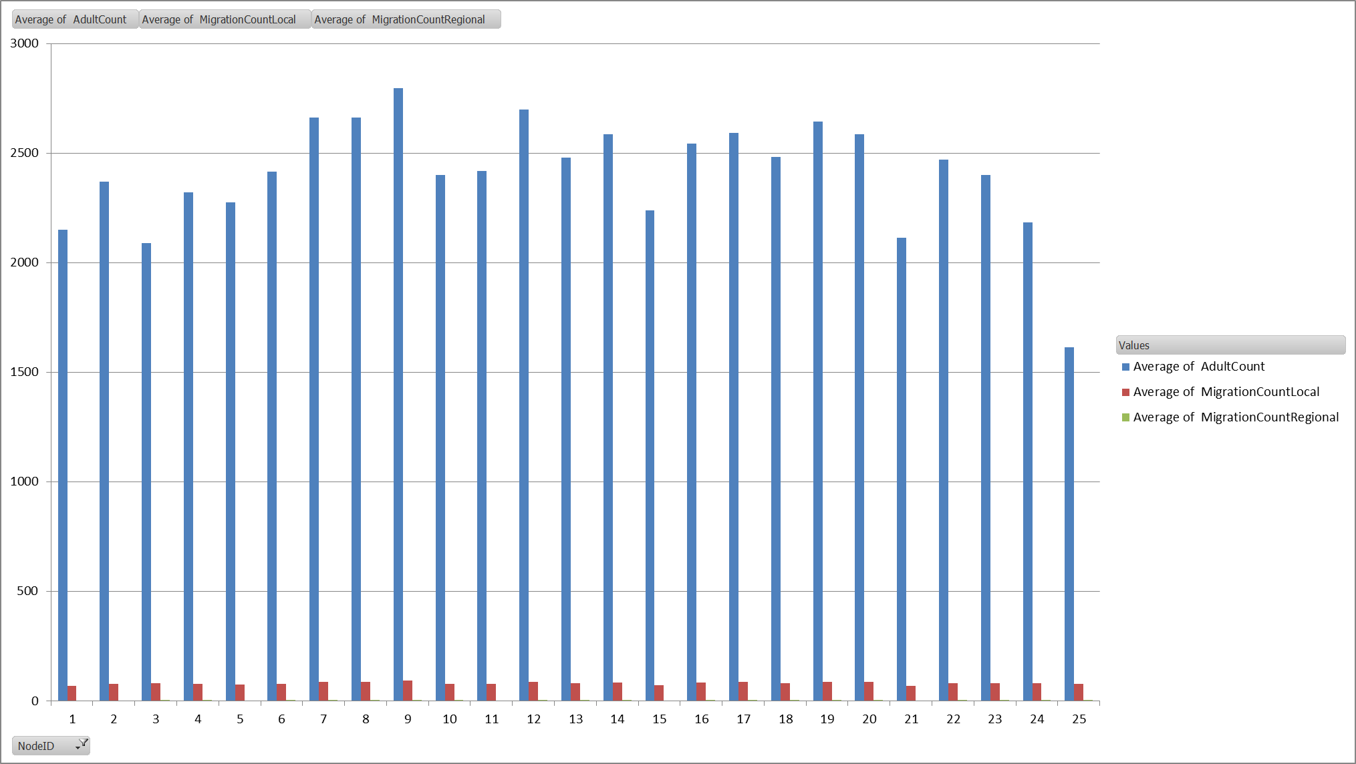
Vector Population vs Migration
"x_Vector_Migration_Local" : 0.1,
"x_Vector_Migration_Regional" : 0.01

Slide 14
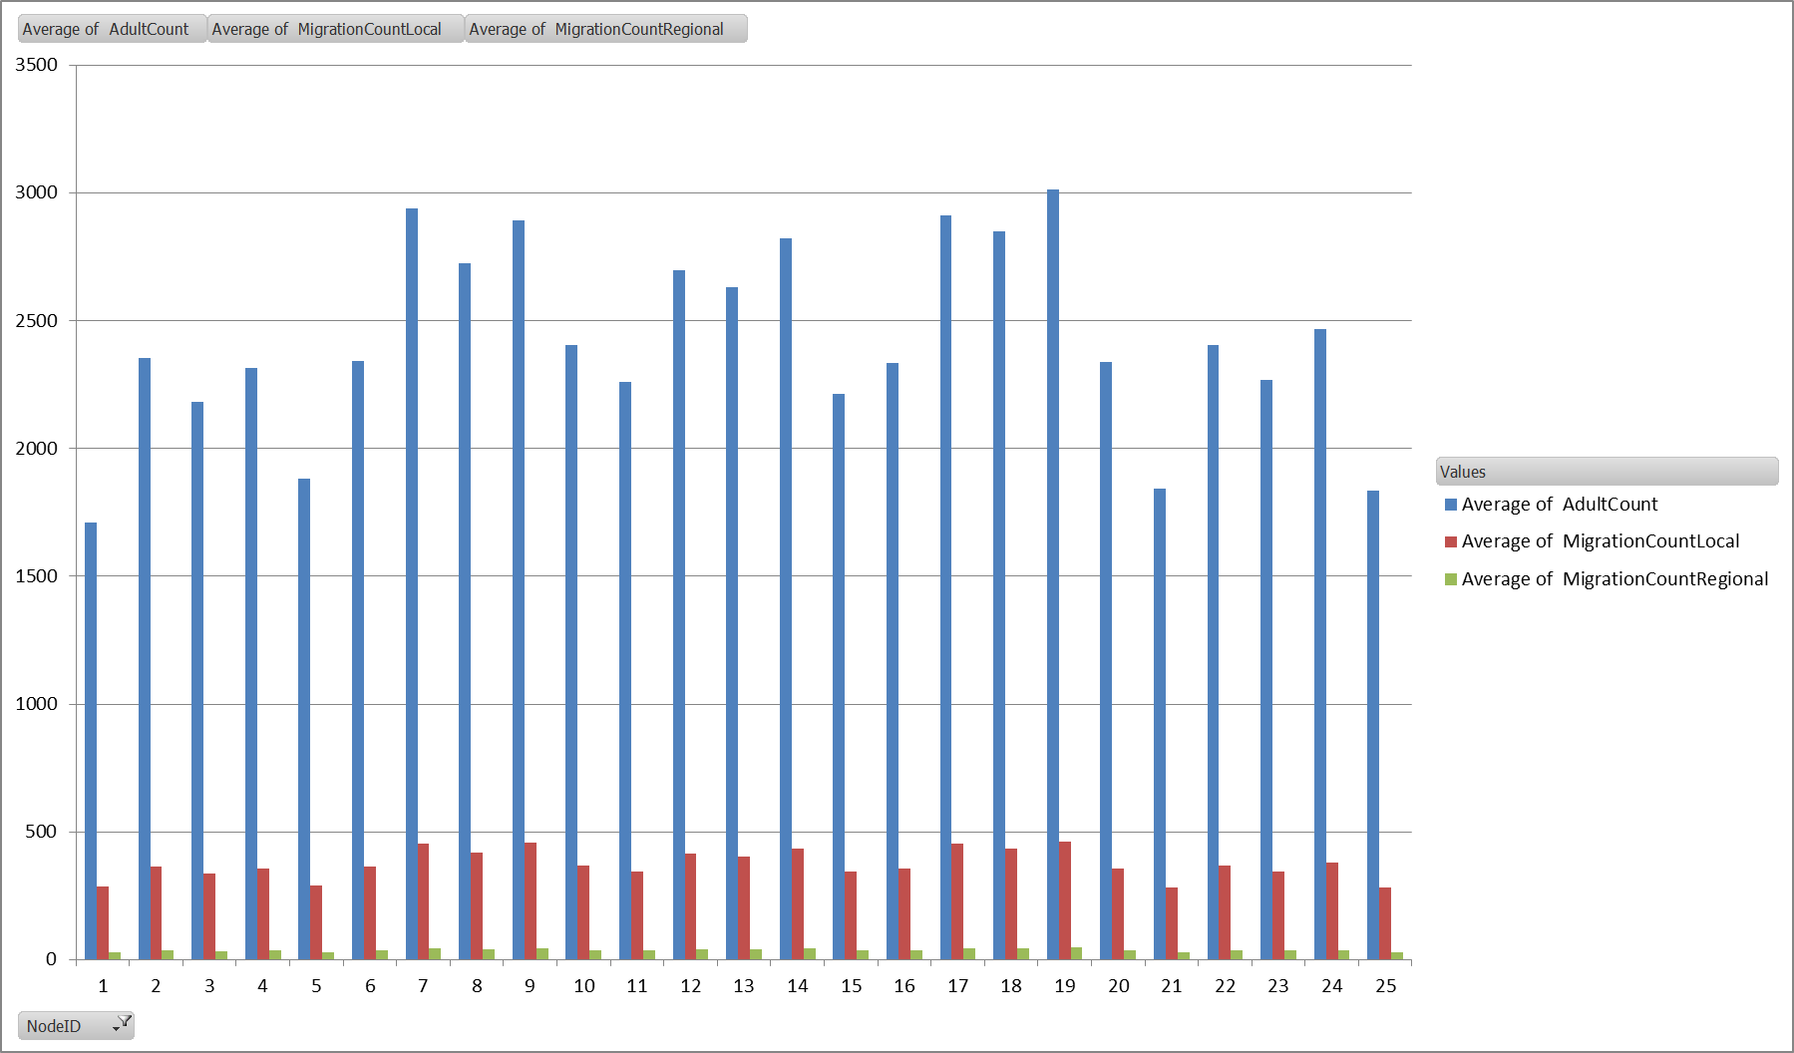
Vector Population vs Migration
Notice that population in corners (1, 5, 25, 21 ) declines
"x_Vector_Migration_Local" : 0.5,
"x_Vector_Migration_Regional" : 0.1
Increasing factors increased the vector migration and the impact can be seen in the vector population of the node.

Slide 15
5x5 Grid of Households
Humans use local migration to adjacent nodes. For example, people in Node 4 can go to 3, 5, 10, 9, & 8. People in Node 1 can only go to 2 & 6.
5
People: 15
Vectors: 50
LHM: 0.5
10
People: 10
Vectors: 50
LHM: 0.5
15
People: 5
Vectors: 100
20
People: 10
Vectors: 100
25
People: 1
Vectors: 100
4
People: 5
Vectors: 50
LHM: 0.5
9
People: 10
Vectors: 100
14
People: 0
Vectors: 100
19
People: 10
Vectors: 100
24
People: 10
Vectors: 100
No Human migration to nodes with zero people except Work Node. That is, no people will go to nodes 7, 14, 16, 21, & 22.
41-400
35-450
46-600
30-900
25- 1200
0-1000
177-4550
3
People: 1
Vectors: 100
8
People: 10
Vectors: 100
13
People: 10
Vectors: 100
18
People: 10
Vectors: 100
23
People: 15
Vectors: 200
LHM: 5.0
0.005 deg
~1813 ft
~0.553 km
LarvalHabitatMultiplier (LHM) is needed to really increase the number of vectors in a node.
2
People: 10
Vectors: 100
7
People: 0
Vectors: 100
12
People: 15
Vectors: 100
17
People: 5
Vectors: 200
LHM: 5.0
22
People: 0
Vectors: 400
LHM: 10.0
Work Node
1
People: 5
Vectors: 100
6
People: 10
Vectors: 100
11
People: 10
Vectors: 200
LHM: 5.0
16
People: 0
Vectors: 400
LHM: 10.0
21
People: 0
Vectors: 400
LHM: 10.0
26
People: 0
Vectors: 1000

Slide 16
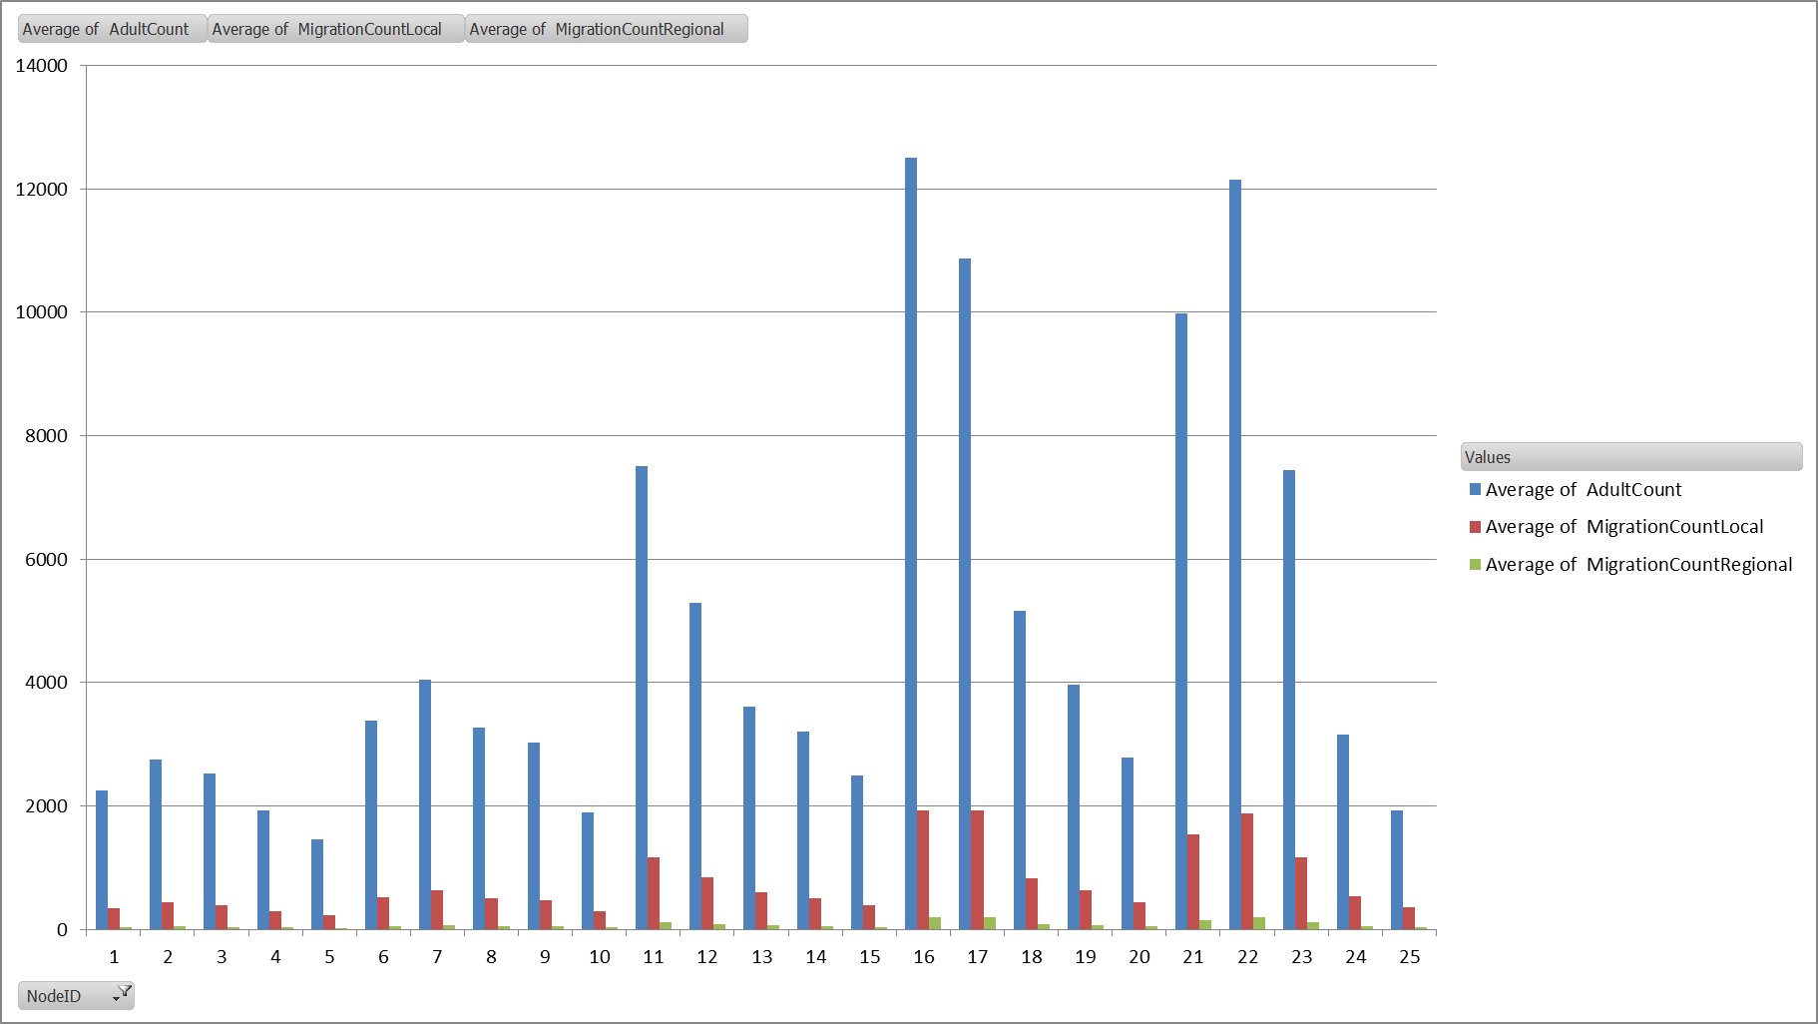
LarvalHabitatMultiplier
"x_Vector_Migration_Local" : 0.5,
"x_Vector_Migration_Regional" : 0.1
Changed LarvalHabitatMultiplier
10.0 – “Swamp” - 16, 21, 22
5.0 – Near “Swamp” - 11, 17, 23
0.5 – Far from “Swamp” - 4, 5, 10

Slide 17
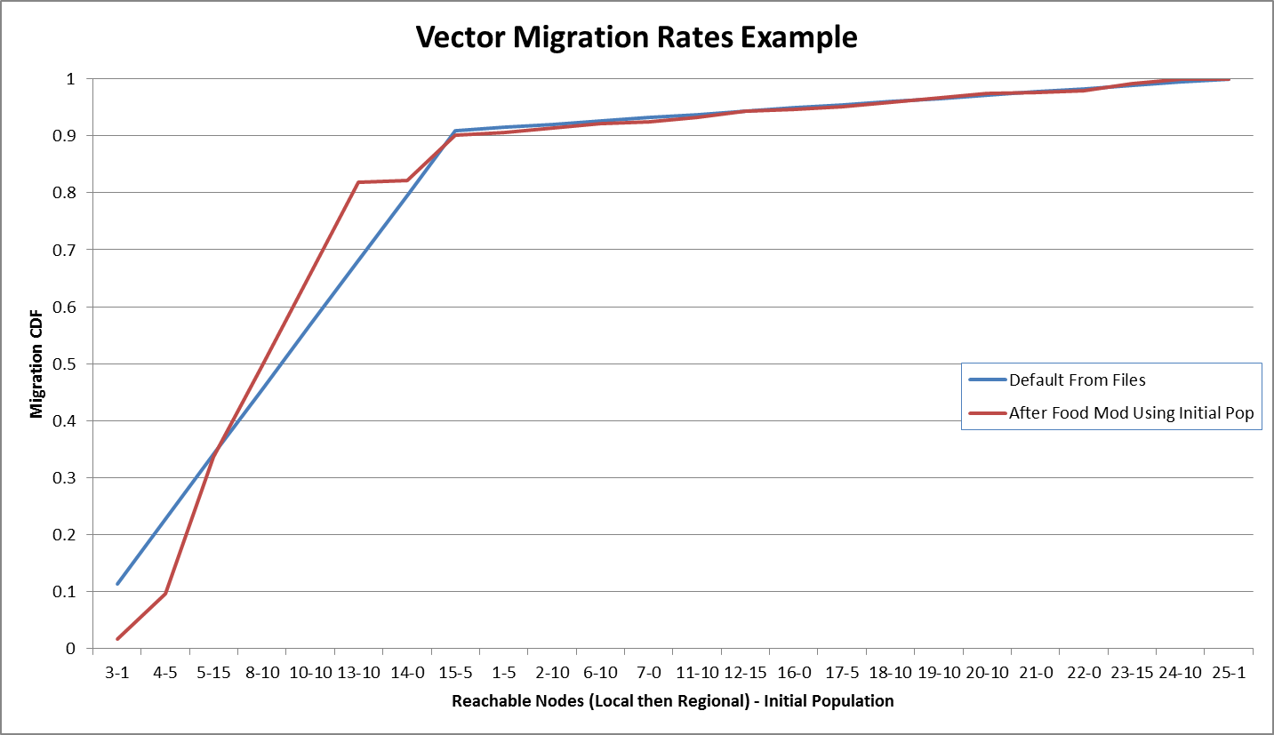
Food Modification
Food Modification modifies the rates to the different nodes based on the population. This is an example using the initial popluation of each node with respect node 9.
OLD
Node 5 has 15 people. This is at least 50% more than surrounding nodes. Hence, it is significantly more likely for vectors to migrate from 9 to 5 because of the more abundance of food.

Slide 18
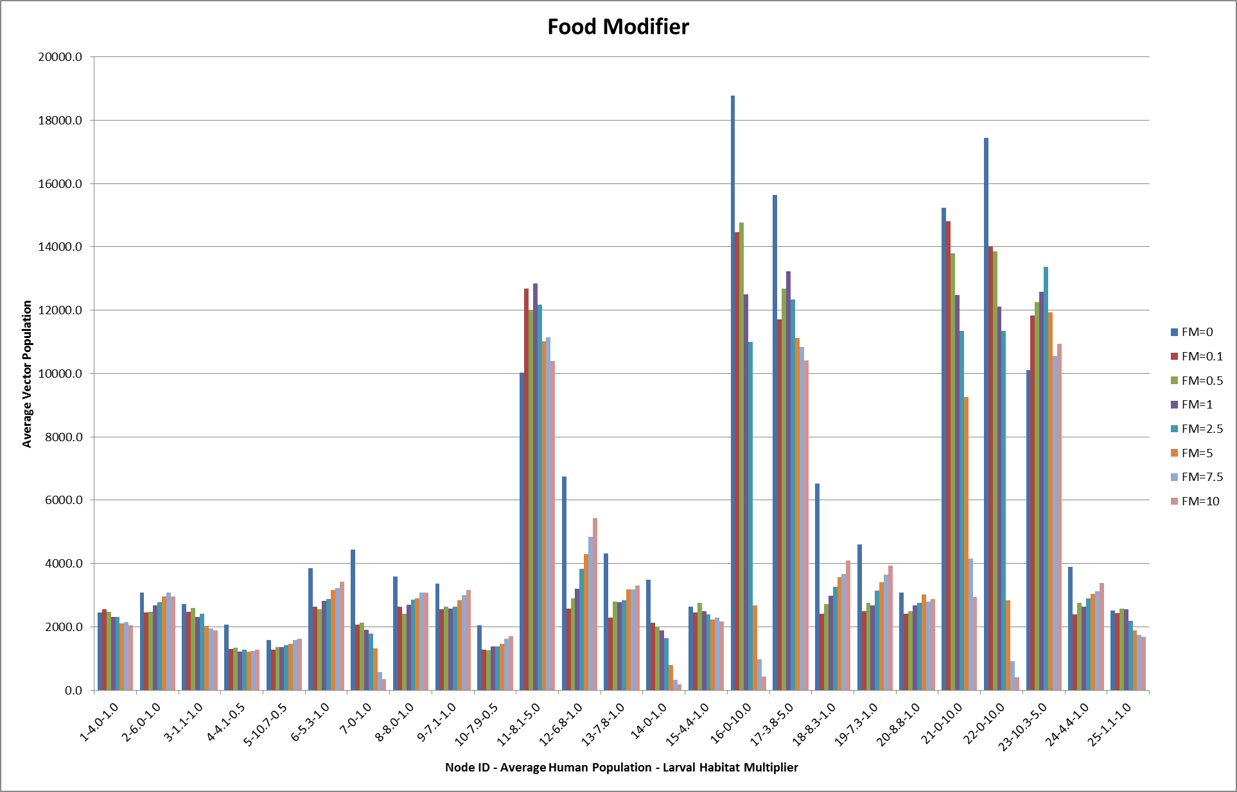
If zero we want to ignore the food modification.
Need to understand why FM=0 is so different.
One can see the trend of nodes with more people getting more vectors the higher the Food Modifier value is.
OLD

Slide 19
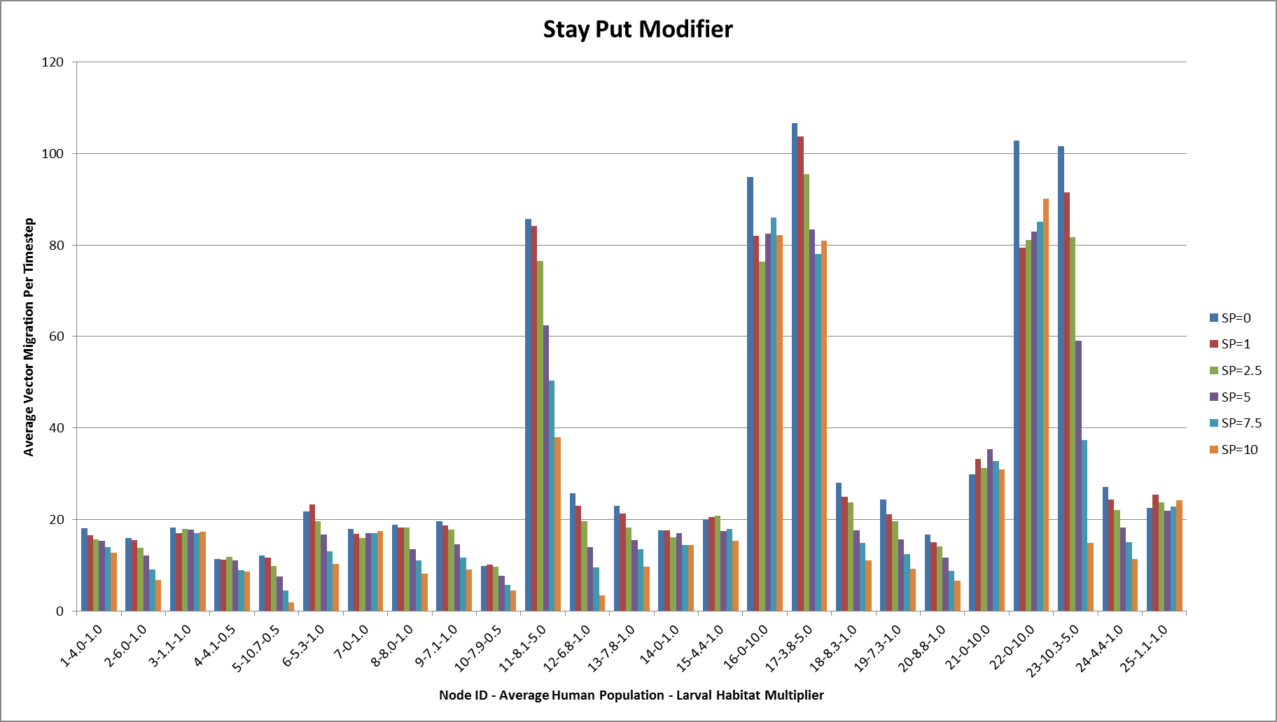
Average Vector Migration
As we increase the Stay Put Modifier, we see nodes with more people having less vector migration
OLD
The Stay Put modifier controls how likely a vector will NOT migrate. It is multiplied times the ratio of people in the node to the total people in the reachable nodes.

Slide 20
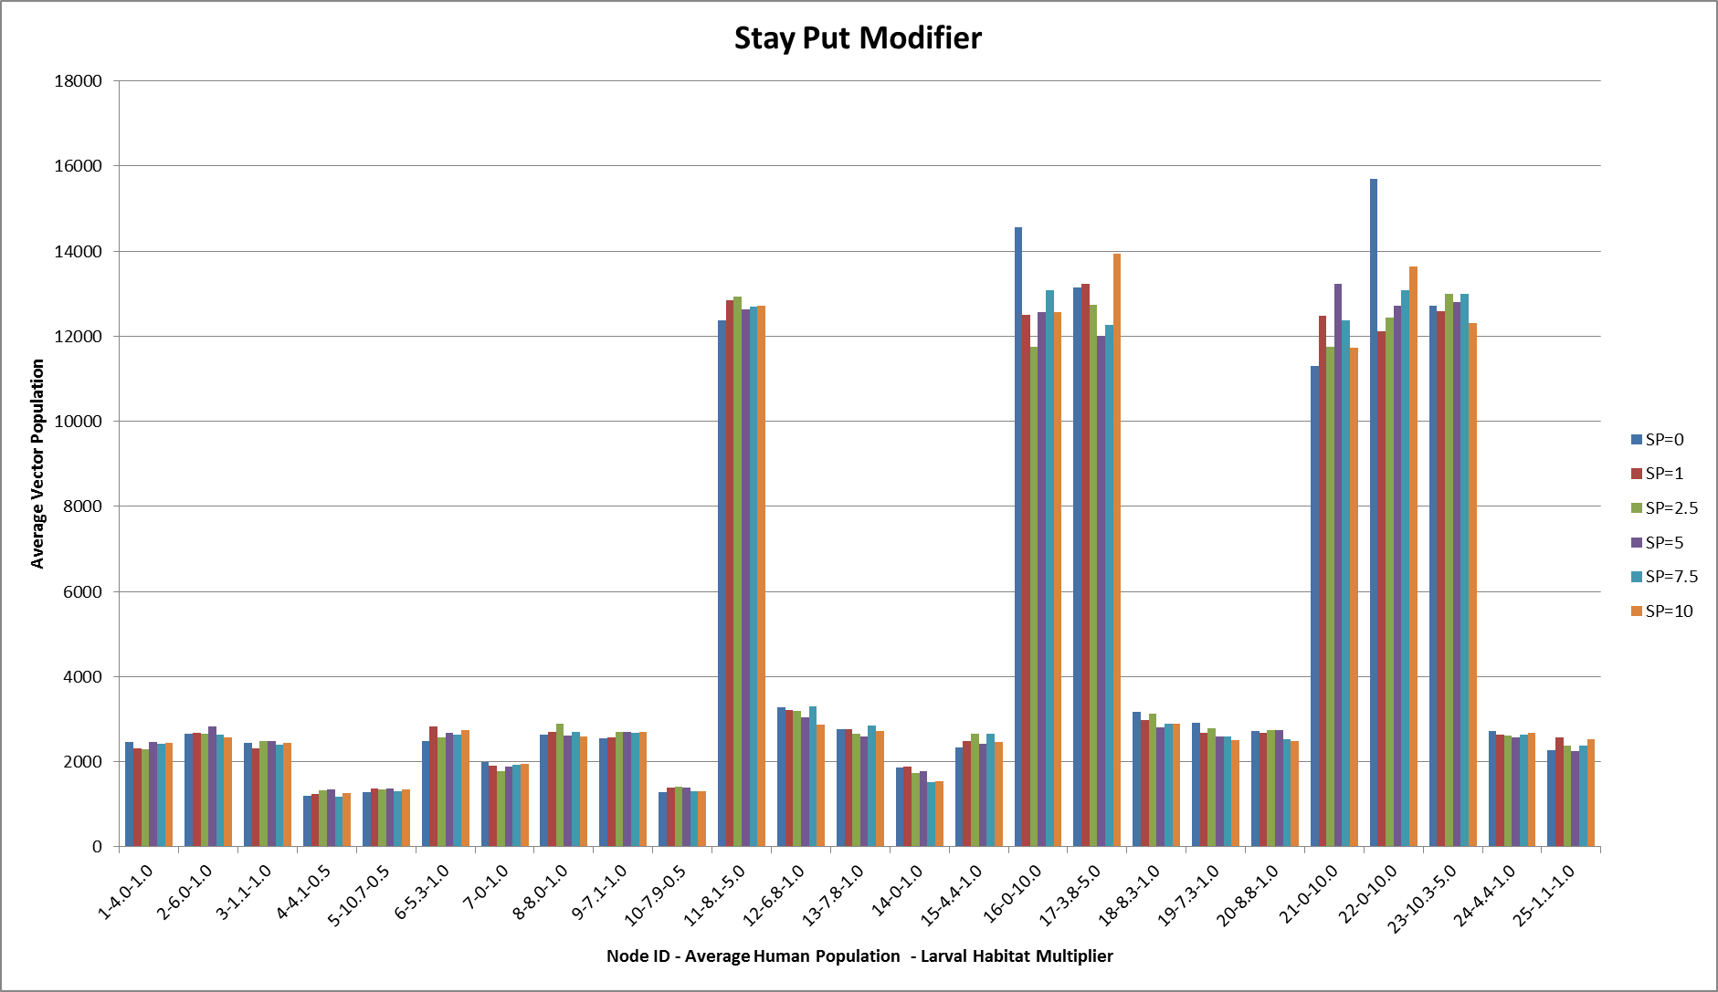
Average Vector Population
The vector migration decreases but the average population is fairly constant.
OLD

Slide 21
Target Neighboring Households
{
"class": "CampaignEvent",
"Event_Name": "Broadcast to Other Households",
"Start_Day": 0,
"Nodeset_Config":
{
"class": "NodeSetAll"
},
"Event_Coordinator_Config":
{
"class": "Standard...Coordinator",
"Demographic_Coverage": 1,
"Intervention_Config":
{
"class": "NodeLevelHealthTriggeredIV",
"Trigger_Condition": "NewClinicalCase",
"Actual_IndividualIntervention_Config":
{
"class": "BroadcastEventToOtherNodes",
"Event_Trigger": "VaccinateNeighbors",
"Include_My_Node" : 1,
"Node_Selection_Type" : "DISTANCE_AND_MIGRATION",
"Max_Distance_To_Other_Nodes_Km" : 1
}
}
}
},
{
"class": "CampaignEvent",
"Event_Name": "Get Vaccinated If Neighbor Infected",
"Start_Day": 0,
"Nodeset_Config":
{
"class": "NodeSetAll"
},
"Event_Coordinator_Config":
{
"class": "Standard...Coordinator",
"Demographic_Coverage": 1,
"Intervention_Config":
{
"class": "NodeLevelHealthTriggeredIV",
"Target_Residents_Only" : 1,
"Trigger_Condition": "TriggerString",
"Trigger_Condition_String": "VaccinateNeighbors",
"Actual_IndividualIntervention_Config":
{
"class": "AntimalarialDrug",
"Cost_To_Consumer": 10,
"Dosing_Type": "FullTreatmentParasiteDetect",
"Drug_Type": "Chloroquine",
"Dont_Allow_Duplicates" : 1
}
}
}
}
Node_Selection_Type – Determines how nodes are selected when sending events to the individuals of other nodes.
- DISTANCE_ONLY – Use only the Max_Distance_To_Other_Nodes_Km
- MIGRATION_NODES_ONLY – Use only the local and regional nodes that are reachable by the node
- DISTANCE_AND_MIGRATION – Use first the distance metric and then reachable migration information
Include_My_Node – Determines if the event should be sent to individuals in the node that the event originated from.
Max_Distance_To_Other_Nodes_Km – The great circle distance in kilometers from the center of originating node to the other nodes.

Slide 22
Trigger Individual Migration
{
"class": "CampaignEvent",
"Event_Name" : "Migrate to Node 5”
"Start_Day": 10,
"Nodeset_Config": {
"Node_List": [
1, 2, 3, 4, 6, 8, 9, 10
],
"class": "NodeSetNodeList"
},
"Event_Coordinator_Config": {
"class": "Standard...Coordinator",
"Target_Residents_Only" : 1,
"Target_Demographic": "Everyone",
"Demographic_Coverage": 1.0,
"Intervention_Config": {
"class": "MigrateTo",
"NodeID_To_Migrate_To": 5,
"Duration_At_Node": 50,
"Is_Family_Trip": 0
}
}
},
NodeID_To_Migrate_To – The ID of the node that the individual is to migrate to
Duration_At_Node – The number of days the individual is to stay at the node before returning home.
Is_Family_Trip – If true, the residents of the node will migrate to the node once everyone is home. If false, the individual will migrate immediately.

Slide 23
Targeting Residents Only
{
"class": "CampaignEvent",
"Event_Name" : "Migrate to Node 5”
"Start_Day": 10,
"Nodeset_Config": {
"Node_List": [
1, 2, 3, 4, 6, 8, 9, 10
],
"class": "NodeSetNodeList"
},
"Event_Coordinator_Config": {
"class": "Standard...Coordinator",
"Target_Residents_Only" : 1,
"Target_Demographic": "Everyone",
"Demographic_Coverage": 1.0,
"Intervention_Config": {
"class": "MigrateTo",
"NodeID_To_Migrate_To": 5,
"Duration_At_Node": 50,
"Is_Family_Trip": 0
}
}
},
{
"class": "CampaignEvent",
"Event_Name": "Get Vaccinated If Neighbor Infected",
"Start_Day": 0,
"Nodeset_Config":
{
"class": "NodeSetAll"
},
"Event_Coordinator_Config":
{
"class": "Standard...Coordinator",
"Demographic_Coverage": 1,
"Intervention_Config":
{
"class": "NodeLevelHealthTriggeredIV",
"Target_Residents_Only" : 1,
"Trigger_Condition": "TriggerString",
"Trigger_Condition_String": "VaccinateNeighbors",
"Actual_IndividualIntervention_Config":
{
"class": "AntimalarialDrug",
"Cost_To_Consumer": 10,
"Dosing_Type": "FullTreatmentParasiteDetect",
"Drug_Type": "Chloroquine",
"Dont_Allow_Duplicates" : 1
}
}
}
}
Can be used in Standard Event Coordinator or NLHTIV
Target_Residents_Only – Allows interventions to be restricted to only the individuals that call the node home (i.e. started out in the node or were born there).

Slide 24
Dont_Allow_Duplicates
{
"class": "CampaignEvent",
"Event_Name": "Get Vaccinated If Neighbor Infected",
"Start_Day": 0,
"Nodeset_Config":
{
"class": "NodeSetAll"
},
"Event_Coordinator_Config":
{
"class": "Standard...Coordinator",
"Demographic_Coverage": 1,
"Intervention_Config":
{
"class": "NodeLevelHealthTriggeredIV",
"Target_Residents_Only" : 1,
"Trigger_Condition": "TriggerString",
"Trigger_Condition_String": "VaccinateNeighbors",
"Actual_IndividualIntervention_Config":
{
"class": "AntimalarialDrug",
"Cost_To_Consumer": 10,
"Dosing_Type": "FullTreatmentParasiteDetect",
"Drug_Type": "Chloroquine",
"Dont_Allow_Duplicates" : 1
}
}
}
}
Since multiple neighbors could get infected, we need a way to keep individuals from getting multiple instances of an intervention.

Slide 25
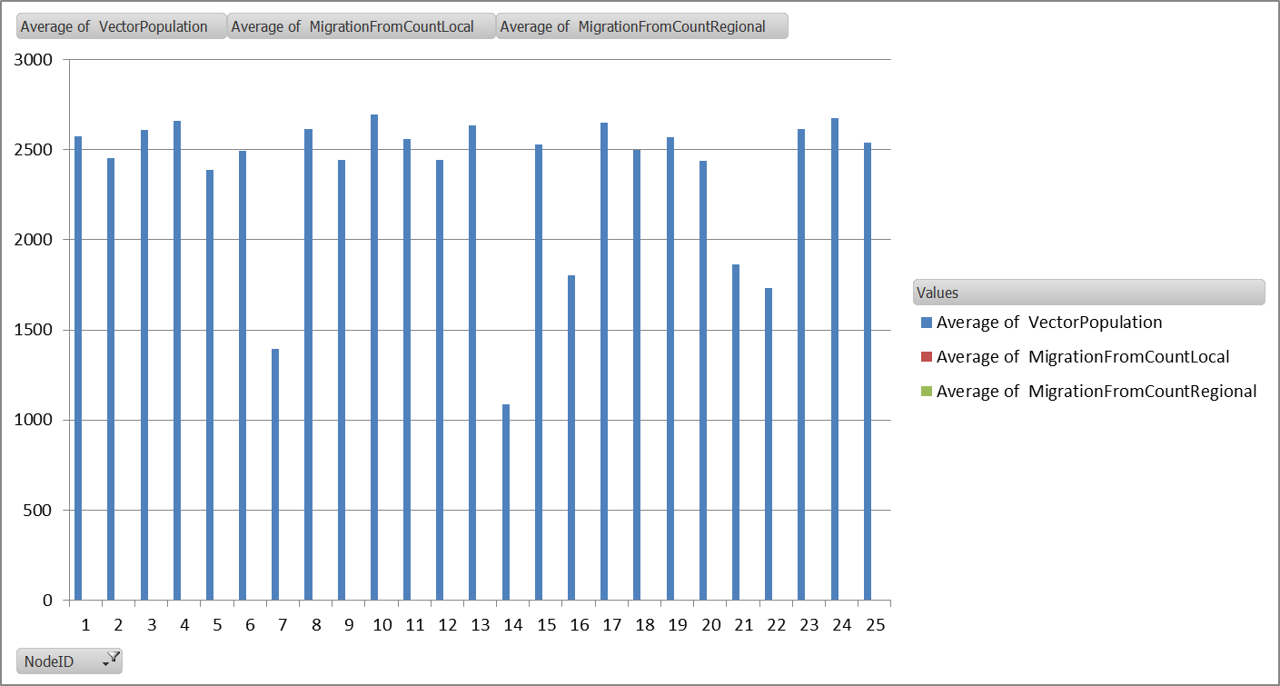
Vector Migration Comparison
"Enable_Vector_Migration": 0,
"Enable_Vector_Migration_Local": 0,
"x_Vector_Migration_Local" : 1.0,
"Enable_Vector_Migration_Regional" : 0,
"x_Vector_Migration_Regional" : 1.0,
"Vector_Migration_Food_Modifier" : 0.0,
"Vector_Migration_Stay_Put_Modifier" : 0.0,
No Migration
LarvalHabitatMulitiplier
- All 1.0
No People

Slide 26
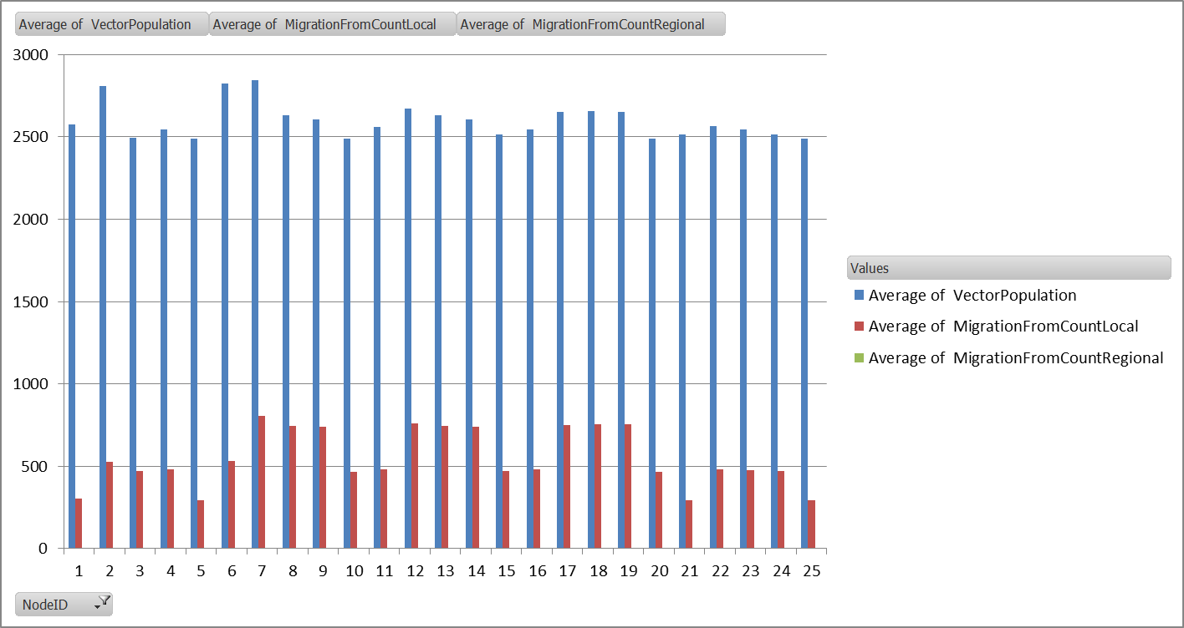
Vector Migration Comparison
"Enable_Vector_Migration": 1,
"Enable_Vector_Migration_Local": 1,
"x_Vector_Migration_Local" : 1.0,
"Enable_Vector_Migration_Regional" : 0,
"x_Vector_Migration_Regional" : 1.0,
"Vector_Migration_Food_Modifier" : 0.0,
"Vector_Migration_Stay_Put_Modifier" : 0.0,
Local Migration
LarvalHabitatMulitiplier
- All 1.0

Slide 27
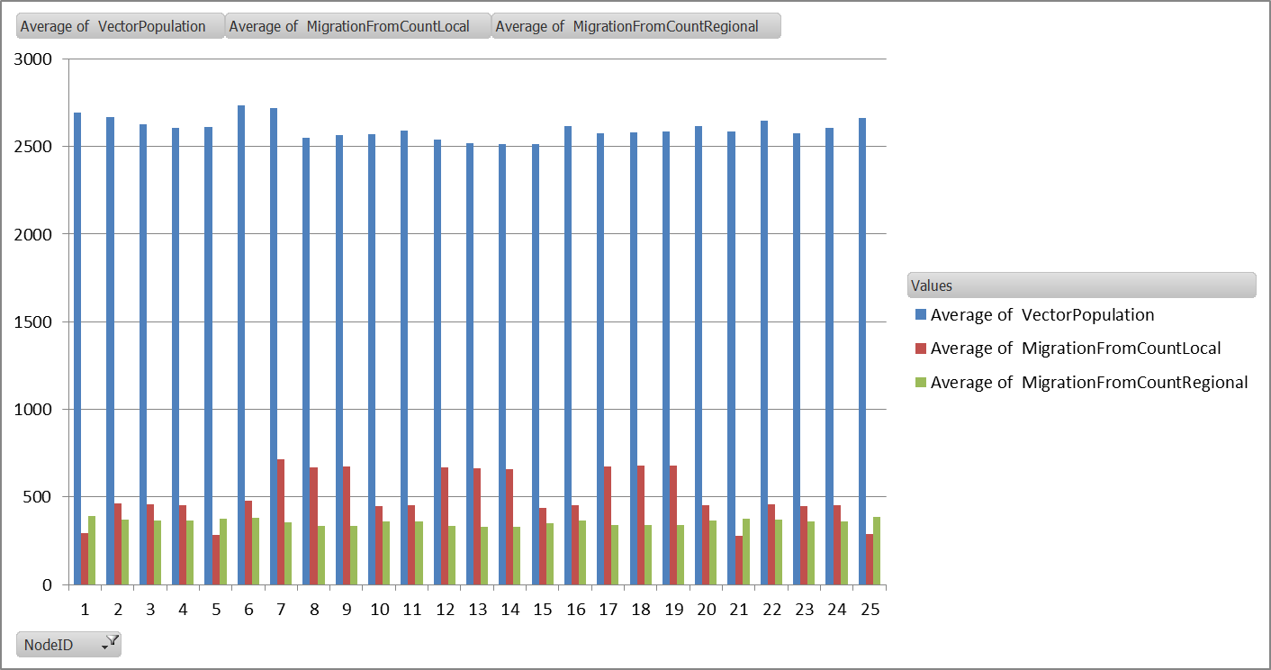
Vector Migration Comparison
"Enable_Vector_Migration": 1,
"Enable_Vector_Migration_Local": 1,
"x_Vector_Migration_Local" : 1.0,
"Enable_Vector_Migration_Regional" : 1,
"x_Vector_Migration_Regional" : 1.0,
"Vector_Migration_Food_Modifier" : 0.0,
"Vector_Migration_Stay_Put_Modifier" : 0.0,
Plus Regional Migration
LarvalHabitatMulitiplier
- All 1.0

Slide 28
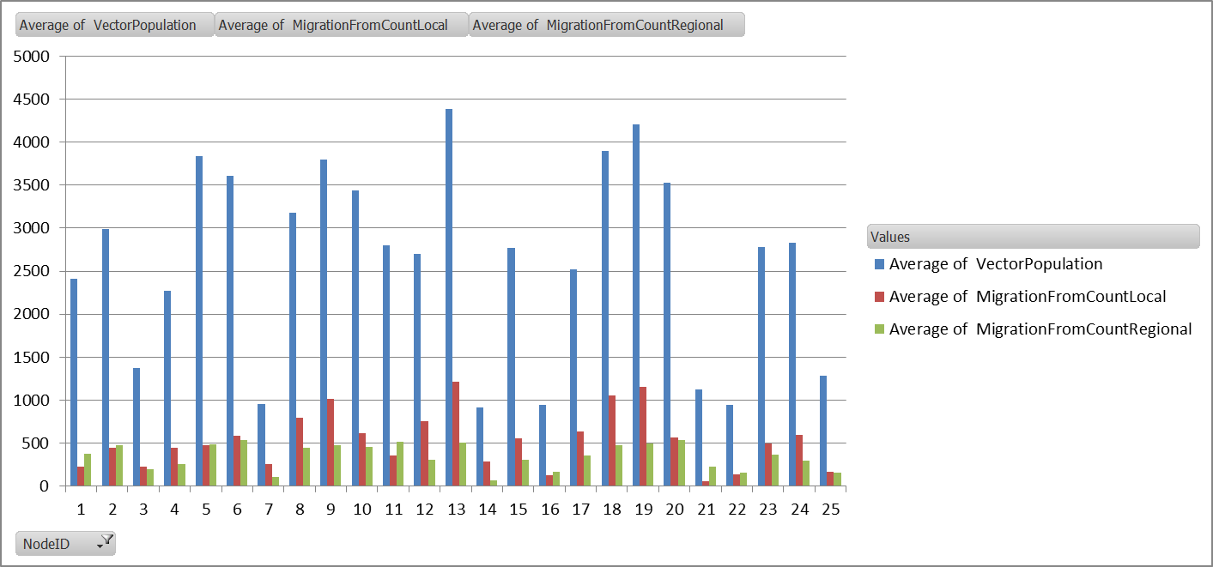
Vector Migration Comparison
"Enable_Vector_Migration": 1,
"Enable_Vector_Migration_Local": 1,
"x_Vector_Migration_Local" : 1.0,
"Enable_Vector_Migration_Regional" : 1,
"x_Vector_Migration_Regional" : 1.0,
"Vector_Migration_Food_Modifier" : 1.0,
"Vector_Migration_Stay_Put_Modifier" : 0.0,
Plus Food Modifier
LarvalHabitatMulitiplier
- All 1.0
Most People
No People

Slide 29
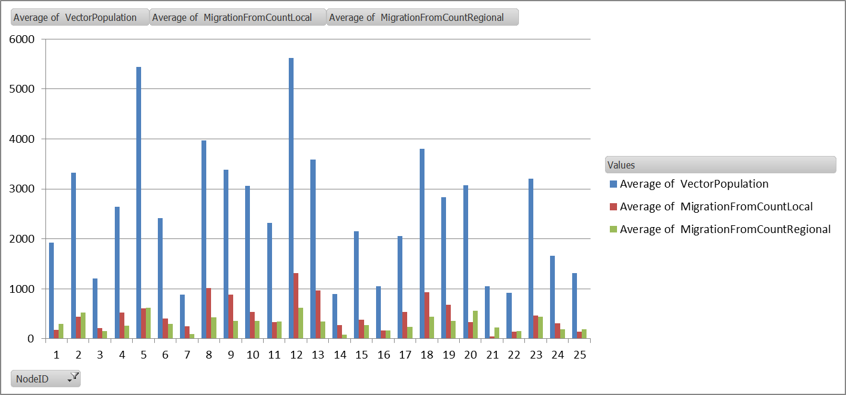
Vector Migration Comparison
"Enable_Vector_Migration": 1,
"Enable_Vector_Migration_Local": 1,
"x_Vector_Migration_Local" : 1.0,
"Enable_Vector_Migration_Regional" : 1,
"x_Vector_Migration_Regional" : 1.0,
"Vector_Migration_Food_Modifier" : 1.0,
"Vector_Migration_Stay_Put_Modifier" : 1.0,
Plus Stay Put Modifier
LarvalHabitatMulitiplier
- All 1.0
Most People
No People

Slide 30
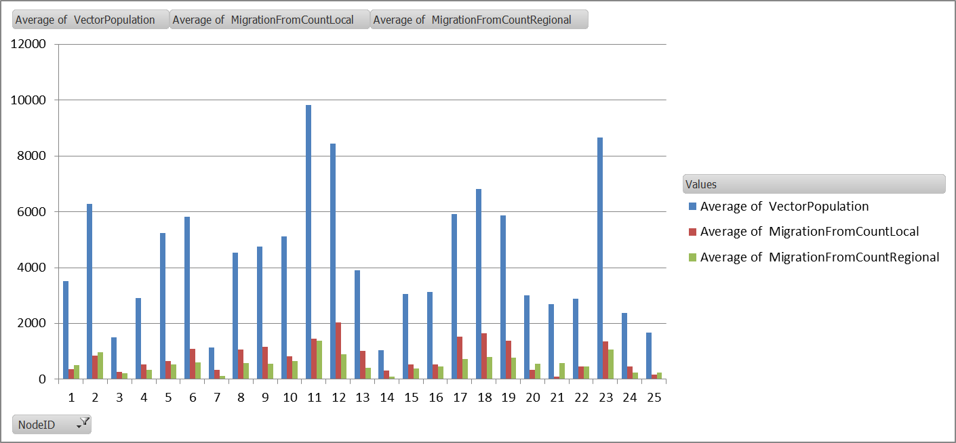
Vector Migration Comparison
"Enable_Vector_Migration": 1,
"Enable_Vector_Migration_Local": 1,
"x_Vector_Migration_Local" : 1.0,
"Enable_Vector_Migration_Regional" : 1,
"x_Vector_Migration_Regional" : 1.0,
"Vector_Migration_Food_Modifier" : 1.0,
"Vector_Migration_Stay_Put_Modifier" : 1.0,
Plus Non-Constant LarvalHabitatMultiplier
LarvalHabitatMulitiplier
10.0 - 16, 21, 22
5.0 - 11, 17, 23
0.5 - 4, 5, 10
Most People
No People

Slide 32
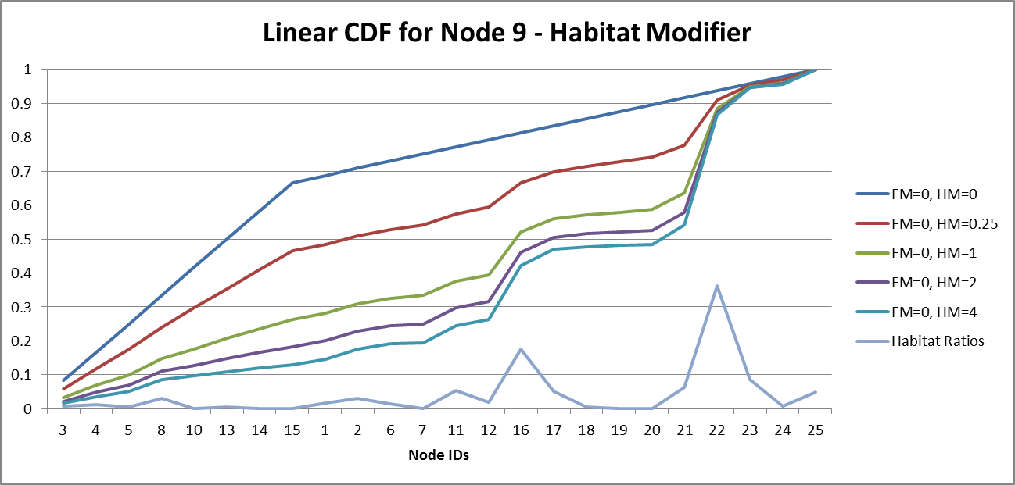
Vector Migration Rates Habitat Modifier
Node 9
Gambiae
Linear
Rate = FileRate + FM*(NodePop/TotalPop) + HM*(Available/TotalAvailable)

Slide 33
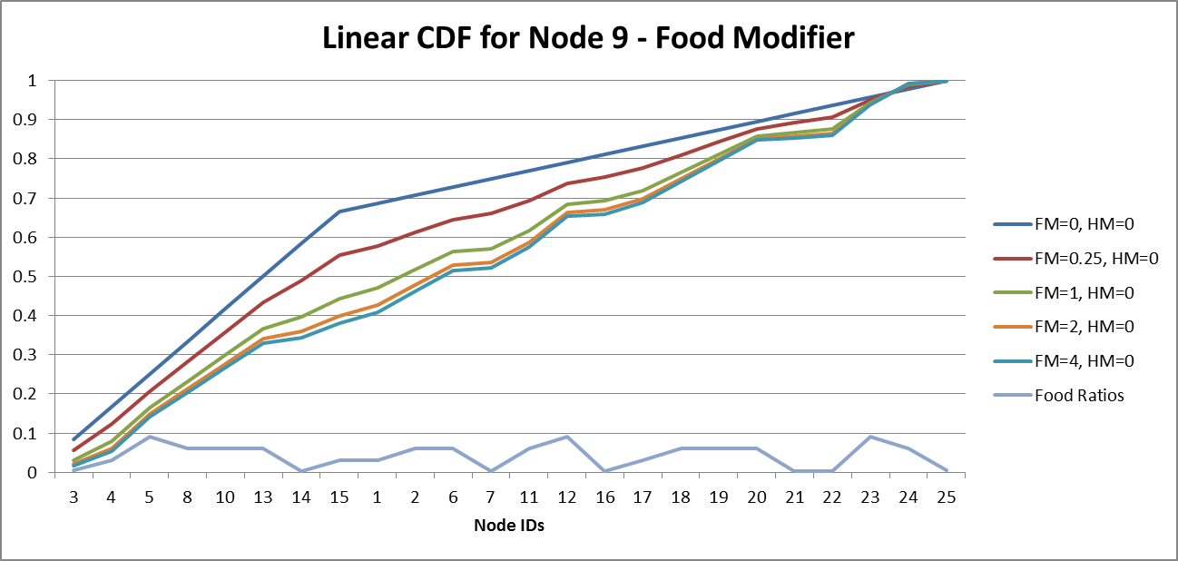
Vector Migration Rates Food Modifier
Node 9
Gambiae
Linear
Rate = FileRate + FM*(NodePop/TotalPop) + HM*(Available/TotalAvailable)

Slide 34
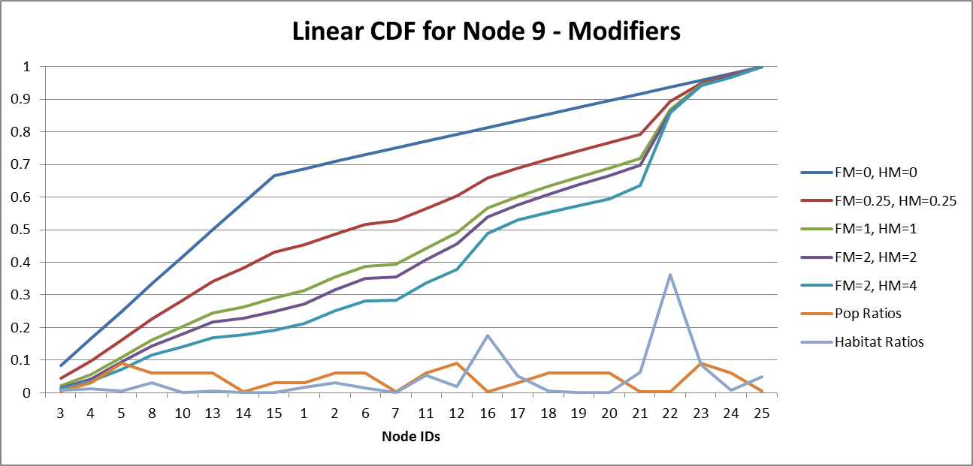
Vector Migration Rates Food & Habitat Modifiers
Node 9
Gambiae
Linear
Rate = FileRate + FM*(NodePop/TotalPop) + HM*(Available/TotalAvailable)

Slide 35
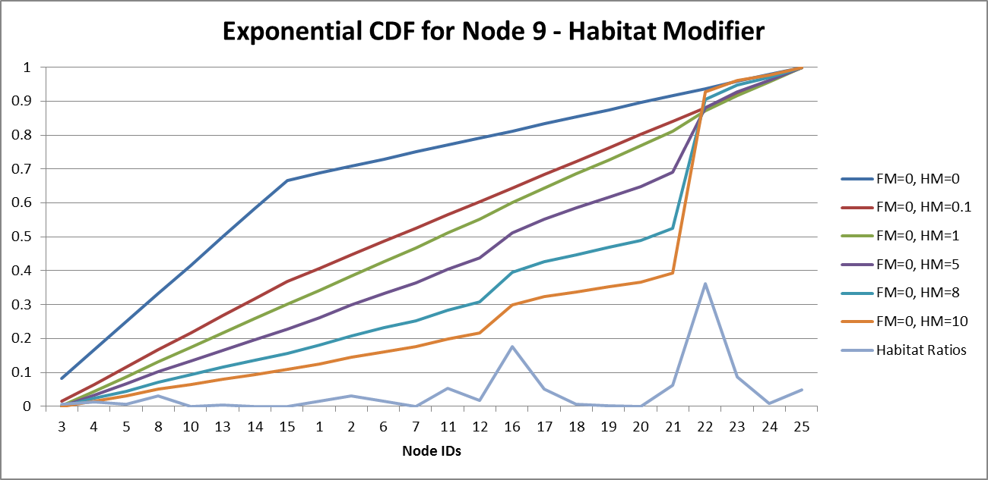
Vector Migration Rates Habitat Modifier
Node 9
Gambiae
Exponential
Rate = FileRate + (exp(FM*(NodePop/TotalPop)) – 1)
+ (exp(HM*(Available/TotalAvailable))-1)

Slide 36
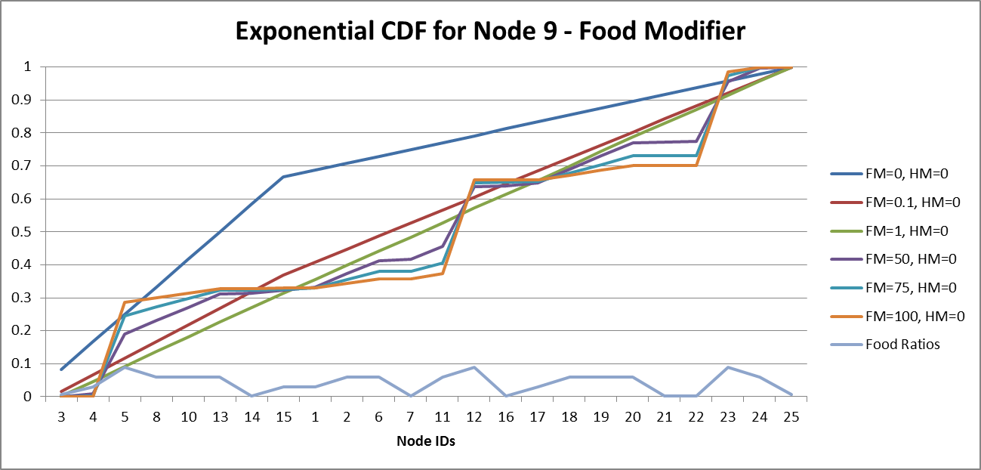
Vector Migration Rates Food Modifier
Node 9
Gambiae
Exponential
Rate = FileRate + (exp(FM*(NodePop/TotalPop)) – 1)
+ (exp(HM*(Available/TotalAvailable))-1)

Slide 37
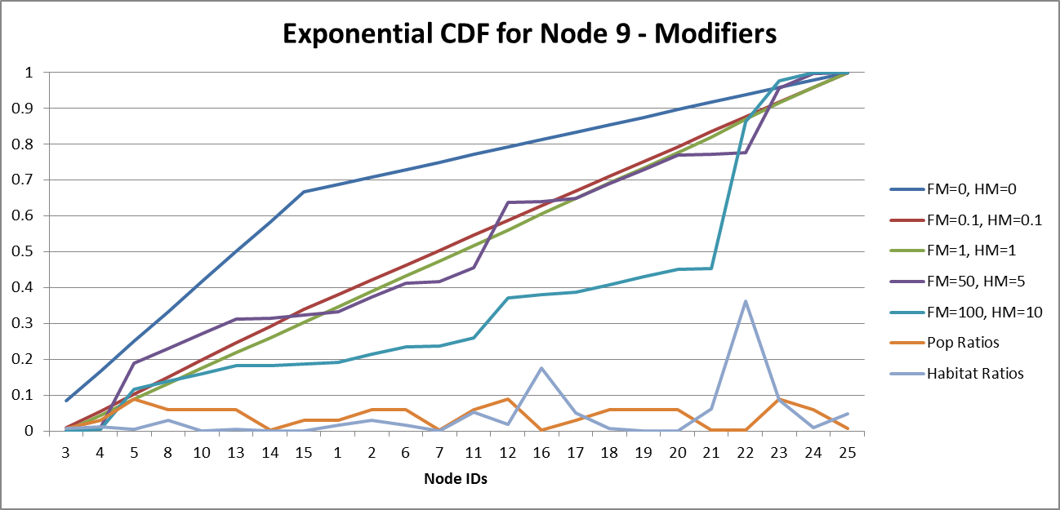
Vector Migration Rates Habitat & Food Modifier
Node 9
Gambiae
Exponential
Rate = FileRate + (exp(FM*(NodePop/TotalPop)) – 1)
+ (exp(HM*(Available/TotalAvailable))-1)

Slide 38
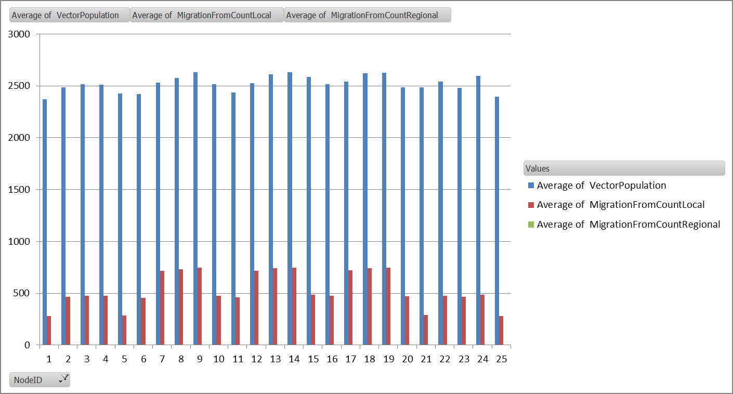
Vector Migration Comparison
"Enable_Vector_Migration_Local": 1,
"x_Vector_Migration_Local" : 1.0,
"Enable_Vector_Migration_Regional" : 0,
"x_Vector_Migration_Regional" : 1.0,
"Vector_Migration_Modifier_Equation” : "EXPONENTIAL”
"Vector_Migration_Habitat_Modifier" : 0.0,
"Vector_Migration_Food_Modifier" : 0.0,
"Vector_Migration_Stay_Put_Modifier" : 0.0,
Local

Slide 39
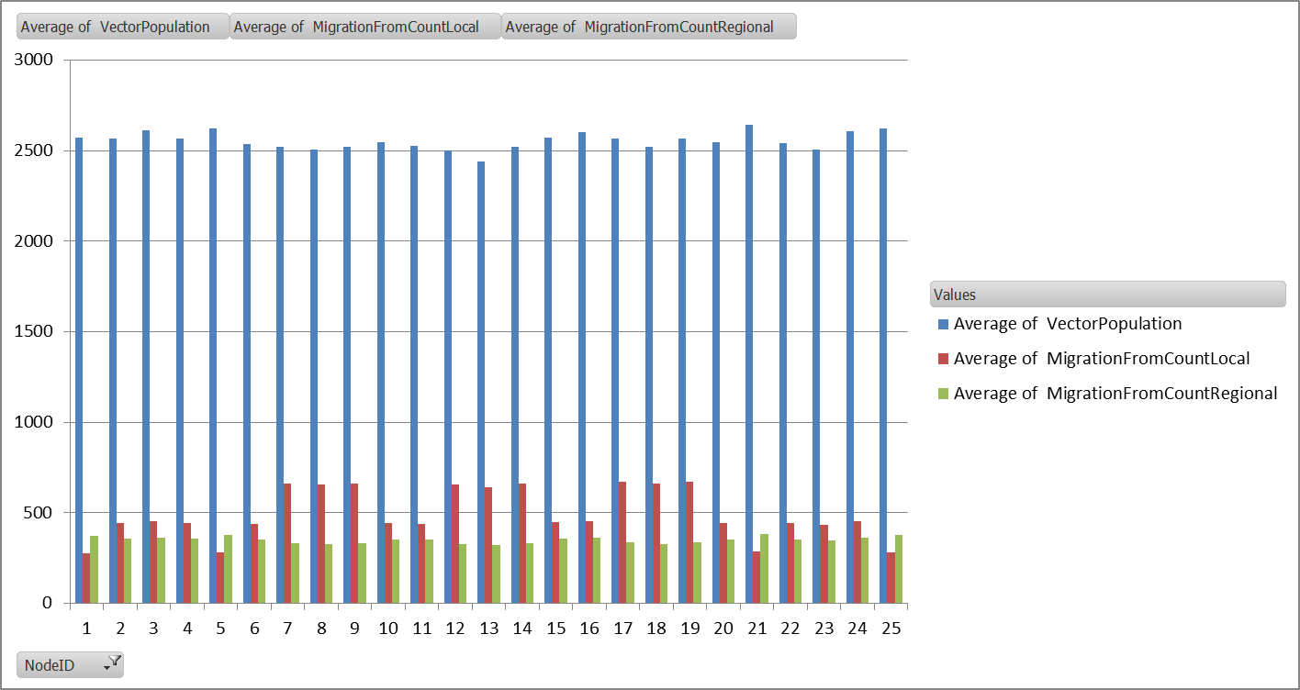
Vector Migration Comparison
"Enable_Vector_Migration_Local": 1,
"x_Vector_Migration_Local" : 1.0,
"Enable_Vector_Migration_Regional" : 1,
"x_Vector_Migration_Regional" : 1.0,
"Vector_Migration_Modifier_Equation” : "EXPONENTIAL”
"Vector_Migration_Habitat_Modifier" : 0.0,
"Vector_Migration_Food_Modifier" : 0.0,
"Vector_Migration_Stay_Put_Modifier" : 0.0,
Local, Regional

Slide 40
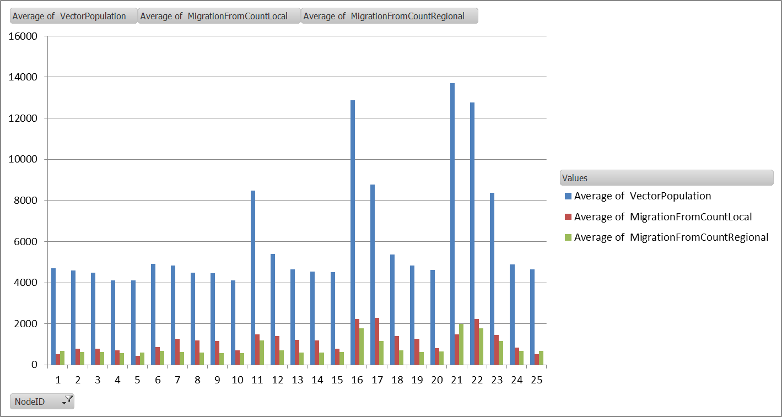
Vector Migration Comparison
"Enable_Vector_Migration_Local": 1,
"x_Vector_Migration_Local" : 1.0,
"Enable_Vector_Migration_Regional" : 0,
"x_Vector_Migration_Regional" : 1.0,
"Vector_Migration_Modifier_Equation” : "EXPONENTIAL”
"Vector_Migration_Habitat_Modifier" : 0.0,
"Vector_Migration_Food_Modifier" : 0.0,
"Vector_Migration_Stay_Put_Modifier" : 0.0,
Local, Regional, LHM
LHM = 0.5, 1.0, 5.0, 10.0
LHM
10.0
LHM
10.0
LHM
10.0
LHM
5.0
LHM
5.0
LHM
5.0
LHM
0.5
LHM
0.5
LHM
0.5

Slide 41
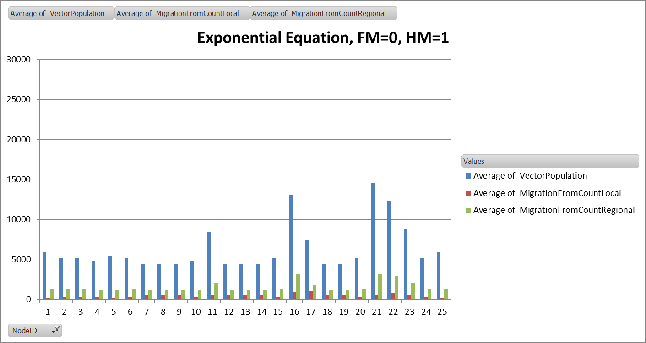
Vector Migration Comparison
"Enable_Vector_Migration_Local": 1,
"x_Vector_Migration_Local" : 1.0,
"Enable_Vector_Migration_Regional" : 0,
"x_Vector_Migration_Regional" : 1.0,
"Vector_Migration_Modifier_Equation” : "EXPONENTIAL”
"Vector_Migration_Habitat_Modifier" : 1.0,
"Vector_Migration_Food_Modifier" : 0.0,
"Vector_Migration_Stay_Put_Modifier" : 0.0,
Local, Regional, LHM, Habitat
LHM
10.0
LHM
10.0
LHM
10.0
LHM
5.0
LHM
5.0
LHM
5.0
LHM
0.5
LHM
0.5
LHM
0.5

Slide 42
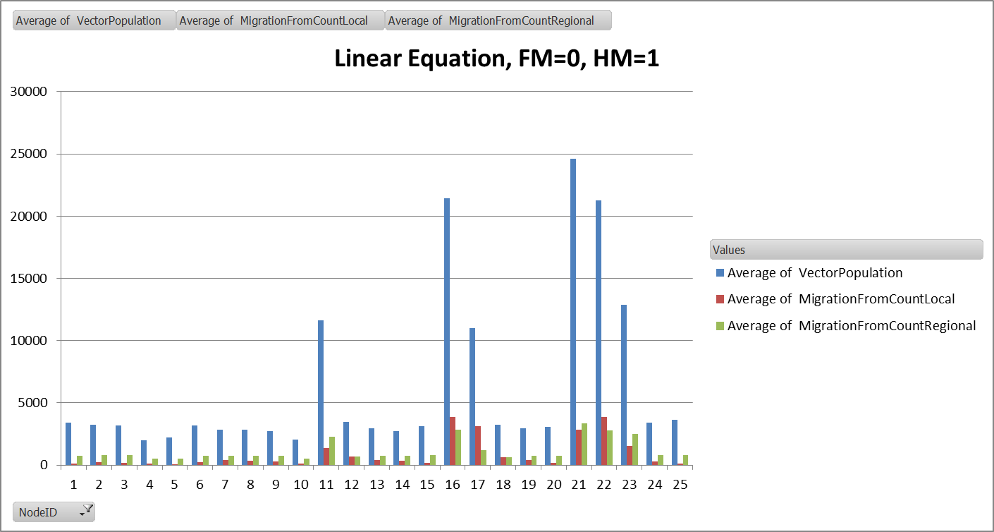
Vector Migration Comparison
"Enable_Vector_Migration_Local": 1,
"x_Vector_Migration_Local" : 1.0,
"Enable_Vector_Migration_Regional" : 0,
"x_Vector_Migration_Regional" : 1.0,
"Vector_Migration_Modifier_Equation” : "LINEAR",
"Vector_Migration_Habitat_Modifier" : 1.0,
"Vector_Migration_Food_Modifier" : 0.0,
"Vector_Migration_Stay_Put_Modifier" : 0.0,
Local, Regional, LHM, Habitat
LHM
10.0
LHM
10.0
LHM
10.0
LHM
5.0
LHM
5.0
LHM
5.0
LHM
0.5
LHM
0.5
LHM
0.5

Slide 43
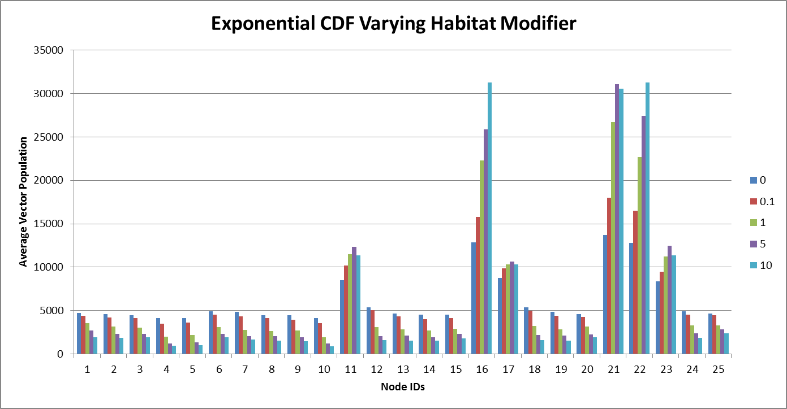
Vector Migration Comparison
"Enable_Vector_Migration_Local": 1,
"x_Vector_Migration_Local" : 1.0,
"Enable_Vector_Migration_Regional" : 0,
"x_Vector_Migration_Regional" : 1.0,
"Vector_Migration_Modifier_Equation” : "EXPONENTIAL",
"Vector_Migration_Habitat_Modifier" : 1.0,
"Vector_Migration_Food_Modifier" : 0.0,
"Vector_Migration_Stay_Put_Modifier" : 0.0,
Local, Regional, LHM, Habitat
No Sea/Work Migration
LHM
10.0
LHM
10.0
LHM
10.0
Vary
Habitat
LHM
5.0
LHM
5.0
LHM
5.0
LHM
0.5
LHM
0.5
LHM
0.5

Slide 44
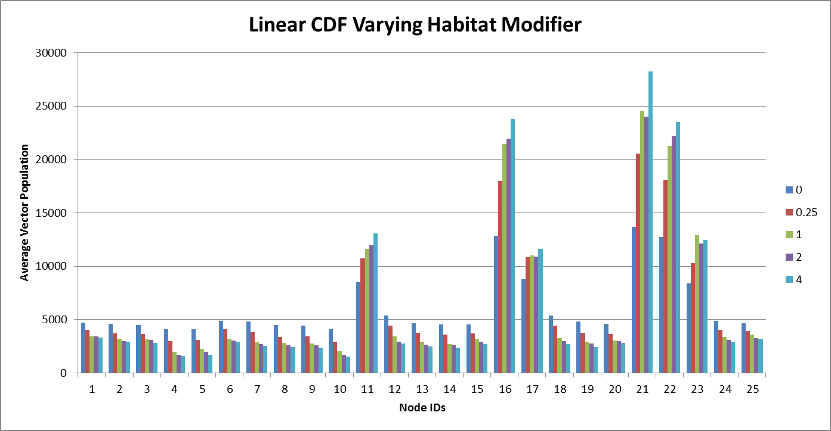
Vector Migration Comparison
"Enable_Vector_Migration_Local": 1,
"x_Vector_Migration_Local" : 1.0,
"Enable_Vector_Migration_Regional" : 0,
"x_Vector_Migration_Regional" : 1.0,
"Vector_Migration_Modifier_Equation” : "LINEAR",
"Vector_Migration_Habitat_Modifier" : 1.0,
"Vector_Migration_Food_Modifier" : 0.0,
"Vector_Migration_Stay_Put_Modifier" : 0.0,
Local, Regional, LHM, Habitat
No Sea/Work Migration
LHM
10.0
LHM
10.0
LHM
10.0
Vary
Habitat
LHM
5.0
LHM
5.0
LHM
5.0
LHM
0.5
LHM
0.5
LHM
0.5

Slide 45
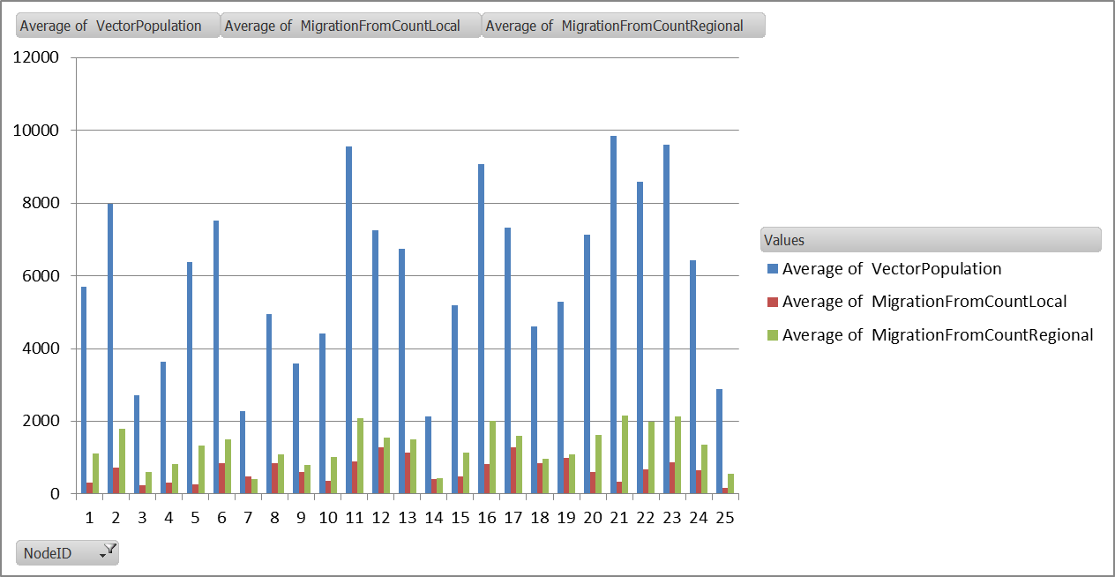
Vector Migration Comparison
"Enable_Vector_Migration_Local": 1,
"x_Vector_Migration_Local" : 1.0,
"Enable_Vector_Migration_Regional" : 0,
"x_Vector_Migration_Regional" : 1.0,
"Vector_Migration_Modifier_Equation” : "LINEAR",
"Vector_Migration_Habitat_Modifier" : 0.0,
"Vector_Migration_Food_Modifier" : 1.0,
"Vector_Migration_Stay_Put_Modifier" : 0.0,
Local, Regional, LHM, Food
Pop
10
Pop
0
LHM
10.0
Pop
0
Pop
15
Pop
0
Pop
10
Pop
10
Pop
15
Pop
15
Pop
5
Pop
5
Pop
1
Pop
0
Pop
1
Pop
0

Slide 46
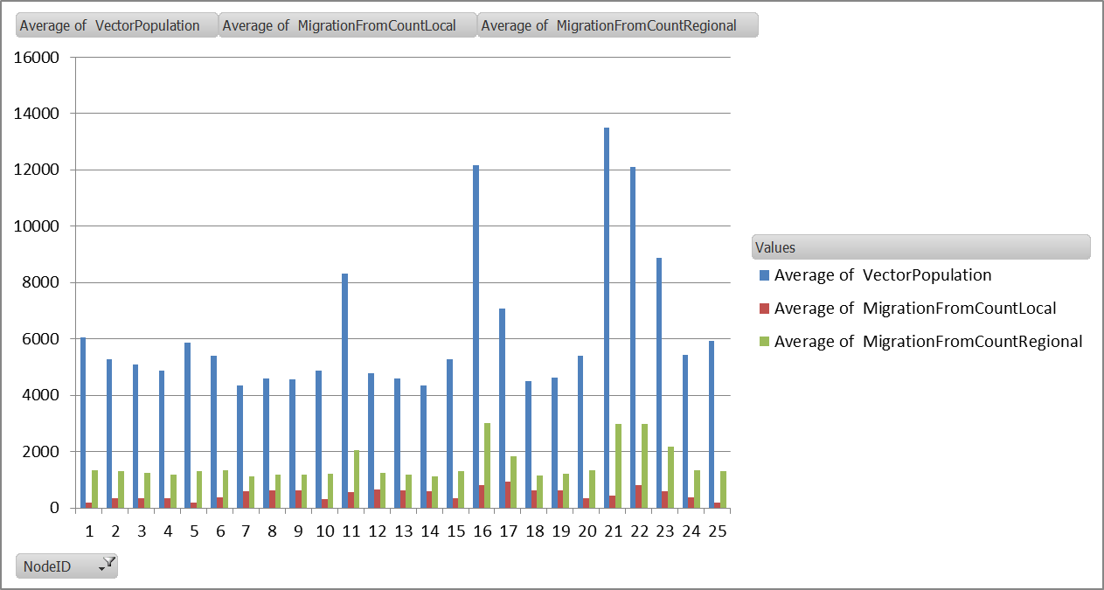
Vector Migration Comparison
"Enable_Vector_Migration_Local": 1,
"x_Vector_Migration_Local" : 1.0,
"Enable_Vector_Migration_Regional" : 0,
"x_Vector_Migration_Regional" : 1.0,
"Vector_Migration_Modifier_Equation” : "EXPONENTIAL",
"Vector_Migration_Habitat_Modifier" : 0.0,
"Vector_Migration_Food_Modifier" : 1.0,
"Vector_Migration_Stay_Put_Modifier" : 0.0,
Local, Regional, LHM, Food
Pop
0
LHM
10.0
Pop
0
Pop
0
Pop
15
Pop
10
Pop
5
Pop
15
Pop
1
Pop
1
Pop
15
Pop
0
Pop
0

Slide 47
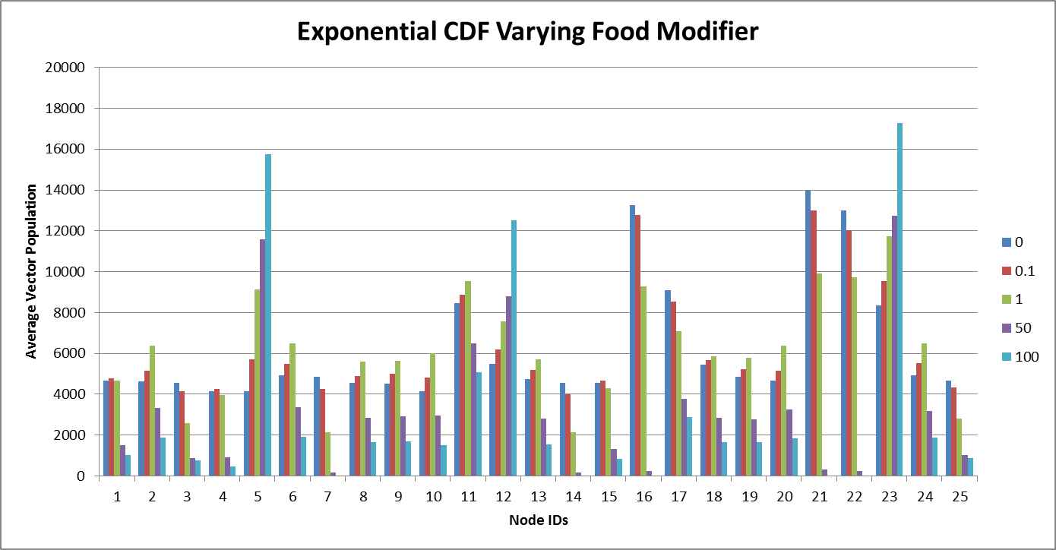
Vector Migration Comparison
"Enable_Vector_Migration_Local": 1,
"x_Vector_Migration_Local" : 1.0,
"Enable_Vector_Migration_Regional" : 0,
"x_Vector_Migration_Regional" : 1.0,
"Vector_Migration_Modifier_Equation” : "EXPONENTIAL",
"Vector_Migration_Habitat_Modifier" : 0.0,
"Vector_Migration_Food_Modifier" : 1.0,
"Vector_Migration_Stay_Put_Modifier" : 0.0,
Local, Regional, LHM, Food
No Sea/Work Migration
Pop
15
Pop
15
Pop
15
Vary
Food
Pop
0
Pop
0
Pop
0
Pop
0
Pop
0

Slide 48
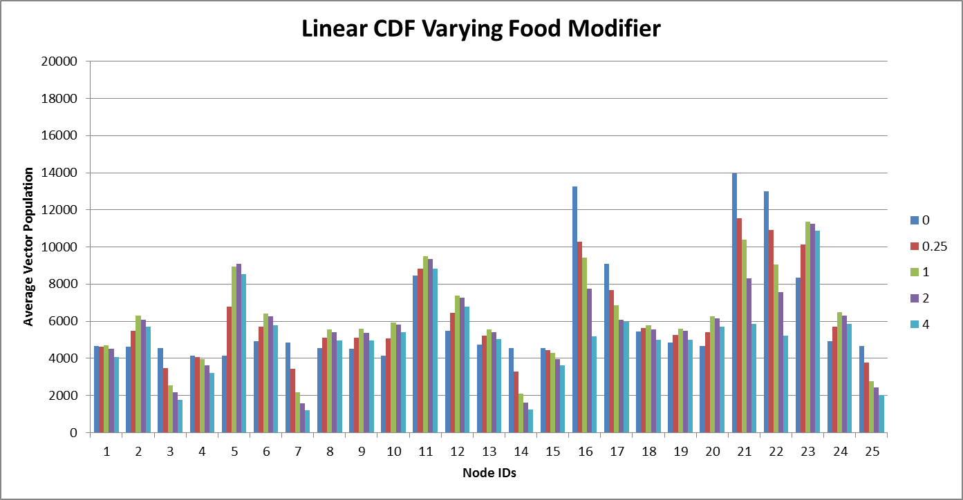
Vector Migration Comparison
"Enable_Vector_Migration_Local": 1,
"x_Vector_Migration_Local" : 1.0,
"Enable_Vector_Migration_Regional" : 0,
"x_Vector_Migration_Regional" : 1.0,
"Vector_Migration_Modifier_Equation” : "LINEAR",
"Vector_Migration_Habitat_Modifier" : 0.0,
"Vector_Migration_Food_Modifier" : 1.0,
"Vector_Migration_Stay_Put_Modifier" : 0.0,
Local, Regional, LHM, Food
No Sea/Work Migration
Pop
15
Pop
15
Pop
15
Vary
Food
Pop
0
Pop
0
Pop
0
Pop
0
Pop
0

Slide 49
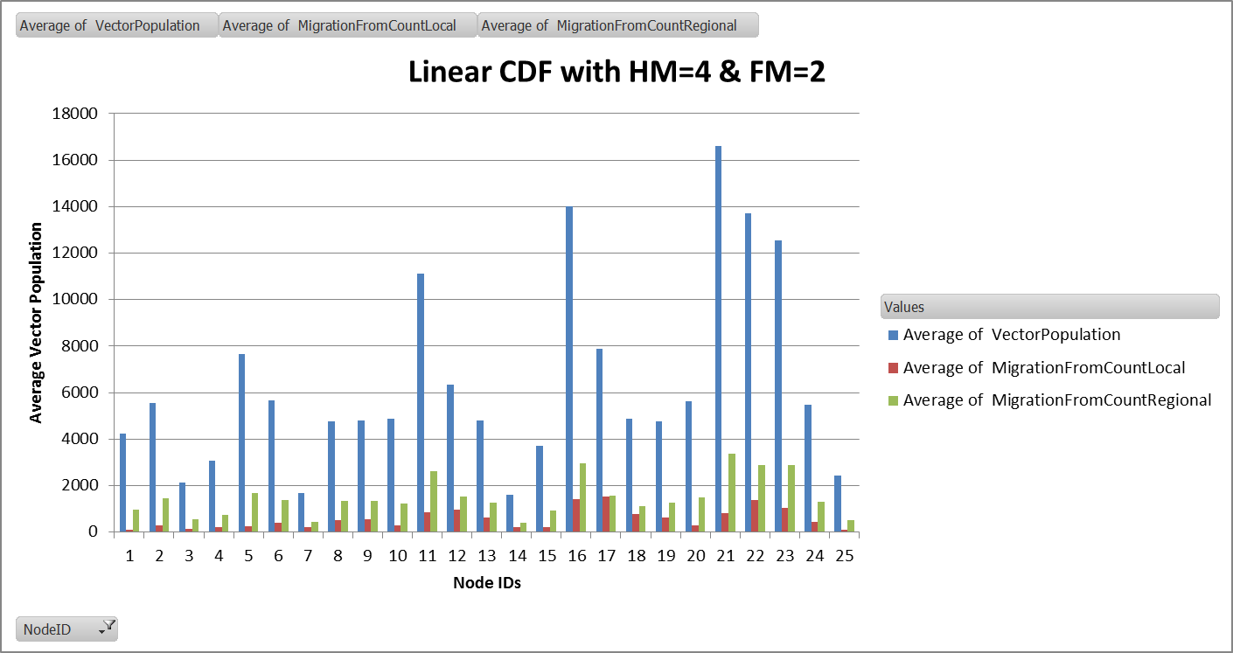
Vector Migration Comparison
"Enable_Vector_Migration_Local": 1,
"x_Vector_Migration_Local" : 1.0,
"Enable_Vector_Migration_Regional" : 0,
"x_Vector_Migration_Regional" : 1.0,
"Vector_Migration_Modifier_Equation” : "LINEAR",
"Vector_Migration_Habitat_Modifier" : 4.0,
"Vector_Migration_Food_Modifier" : 2.0,
"Vector_Migration_Stay_Put_Modifier" : 0.0,
Local, Regional, LHM, Food, Habitat
No Sea/Work Migration
LHM
10.0
LHM
10.0
LHM
10.0
LHM
5.0
Pop
0
Pop
0
Pop
0
Pop
15
LHM
5.0
Pop
15
LHM
5.0
LHM
0.5
LHM
0.5
Pop
15
LHM
0.5
Pop
0
Pop
0
Pop
1
Pop
1

Slide 50
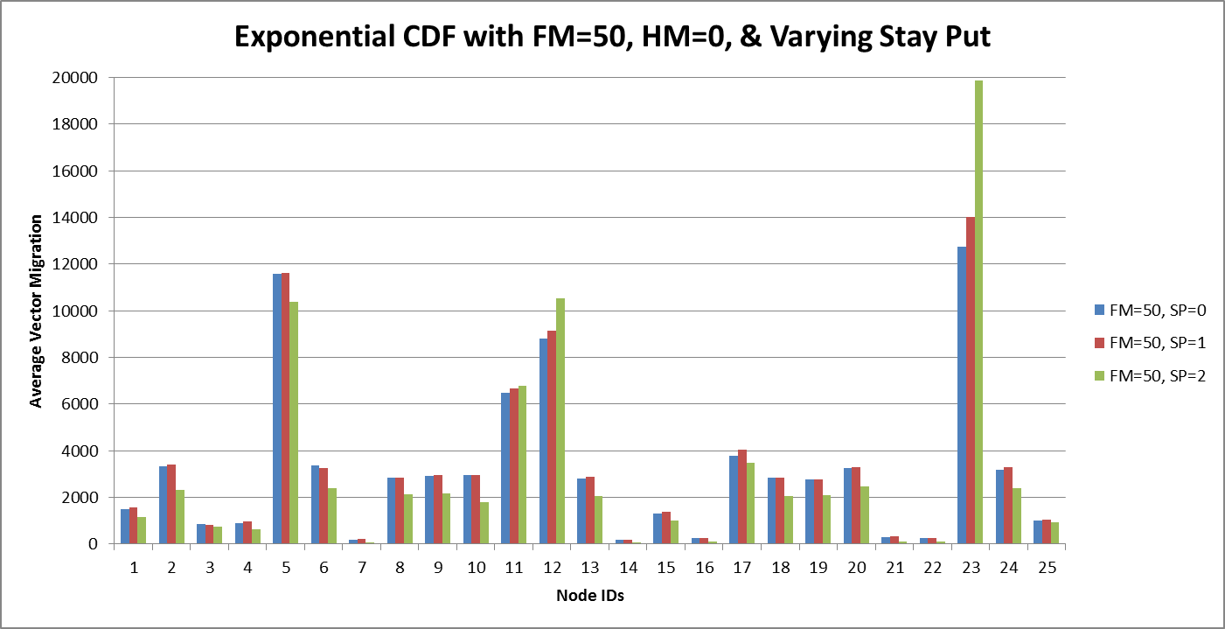
Vector Migration Comparison
"Enable_Vector_Migration_Local": 1,
"x_Vector_Migration_Local" : 1.0,
"Enable_Vector_Migration_Regional" : 0,
"x_Vector_Migration_Regional" : 1.0,
"Vector_Migration_Modifier_Equation” : "LINEAR",
"Vector_Migration_Habitat_Modifier" : 0.0,
"Vector_Migration_Food_Modifier" : 1.0,
"Vector_Migration_Stay_Put_Modifier" : 1.0,
Local, Regional, LHM, Food, Stay
No Sea/Work Migration
Pop
15
Pop
15
Pop
15
Pop
1
Pop
0
Pop
0
Pop
0
Pop
0
Pop
0
Pop
1

Slide 51
Stay Put Average Vectors Migrating From Node
Local
Regional
High human population nodes have less vector migration because we ask them to stay put.
Low human population nodes have more vector migration because there is not much incentive to stay put.

Slide 52
Vector Feeding Cycle and Migration
We can’t inject migration into feeding cycle because of the way we process nodes. Physical movement of vectors has to happen all at once for all nodes.
NodeVector::updateInfectivity()
updatePopulationStatistics()
For each habitat
habitat->Update()
Simulation::Update()
For each vector population
population>UpdateVectorPopulation()
event_context_host->Update(dt)
Node::Update()
Reports_BeginTimestep()
UpdateWeather()
processEmigratingVetors()
UpdateInterventions()
Removes vector from node and puts in migration queue
For each node
node->Update()
updateInfectivity()
For each individual
individual->Update()
resolveMigration()
Determines if, when, where to migrate
updateVitalDynamics()
Increment Time
Human migration
Removes individual from node and puts in migration queue
Reports_EndTimestep()
Migrating individuals and vectors are moved to new nodes

Slide 53
Vector Feeding Cycle and Migration
NodeVector::updateInfectivity()
VectorPopulation::UpdateVectorPopulation()
updatePopulationStatistics()
Update_Egg_Hatching(dt);
Update_Infectious_Queue(dt);
Update_Infected_Queue(dt);
Update_Adult_Queue(dt);
Update_Male_Queue(dt);
Update_Immature_Queue(dt);
Update_Larval_Queue(dt);
Update_Egg_Laying(dt);
For each habitat
habitat->Update()
For each vector population
population>UpdateVectorPopulation()
processEmigratingVetors()
Removes vector from node and puts in migration queue
VectorPopulationIndividual::Update_Adult_Queue()
For each adult
IncreaseAge()
ProcessFeedingCycle()
VectorPopulationIndividual::ProcessFeedingCycle()

Slide 54
To Do
1 - Vector Migration
Add ability to migrate to larger larval habitat
Add to inset chart
Adding migration files like for individuals. We need the ability for vectors to go to nodes that individuals do not.
Vector tracking custom report and scripts
Support for vectors favoring nodes with more people
Might not migrate if current node has more people, but still might leave if not feeding
2 - Interventions
Target people that belong to a particular household even if they are not home
Still need ability to target everyone currently present in a node
Target neighboring households
Would like to be able to specify a distance
Need to use distance and local and regional nodes so we don’t include households not part of the village
Trigger individual migration – men and family to “work” node
Specify duration at node
Add a blackout period to NLHTIV so that it stops listening for events for the given period after it received an event.
3 - Multiple Villages
4 – Household Interventions
Sometimes the intervention is given to the household. For example, 5 bed nets are given to a house and people use them when they are at the house. This could apply to drugs as well (i.e. extra blister packs iareleft )
Sometimes people take the bednet with them and sometimes they leave it at home
Sometimes they get a bed net when the visit a household (i.e. employer has bednets for employees but they stay there)
Need to worry about who gets the bed nets
Need to worry about whether nor not they use it
Need to worry about how a new distribution of beds nets to a household impact who has what
4 - Clinic
Keep track of how many doses and type are being handed out
Where it is
What drugs it is giving out
Restocking
Auto restock (vs intervention)
Duration between
How many doses are in a restock shipment
Don’t worry about people migrating to clinics
Interventions
Health triggered intervention but the closer you are to the clinic the more likely you are to go
Ability to add a clinic
Ability to restock clinic
5 - Individuals
Form relationship and start new household (low priority)
End of quarter to show one simple village

Slide 55
Updates
10/16/2015
Due to Jaline’s survey of research papers on vector migration, she requested that we change our modifiers.
Habitat should just be based on Current Larval Capacity and not to take Larval Count into account.
Previously, we took the Current Larval Capacity minus the number of larva

Slide 56
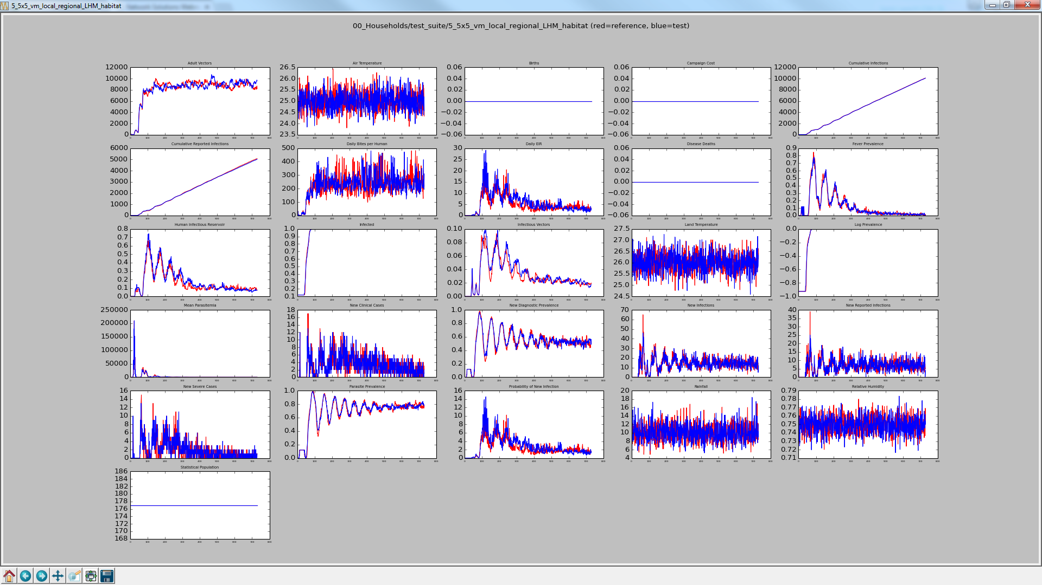
5_5x5_vm_local_regional_LHM_habitat

Slide 57
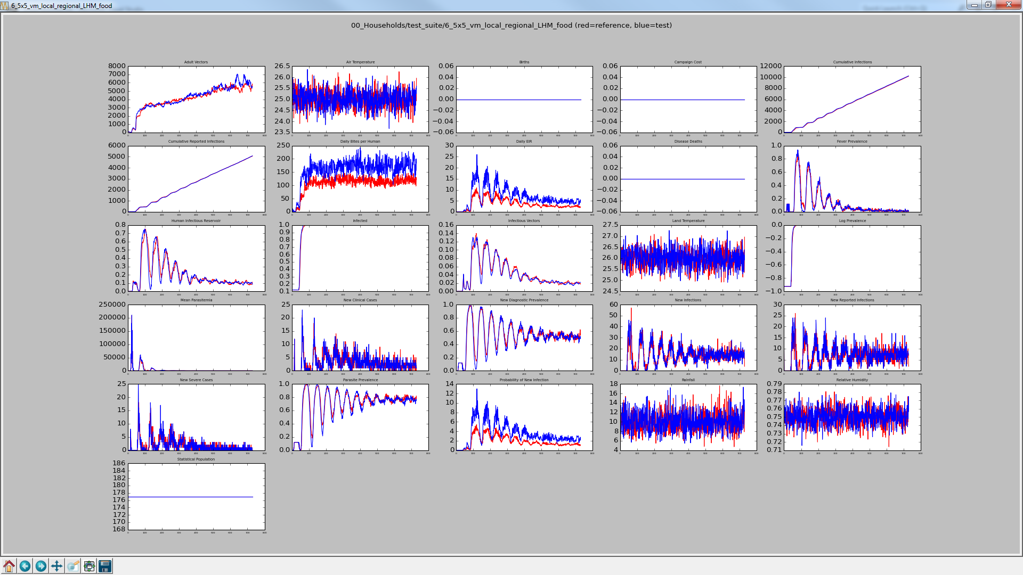
6_5x5_vm_local_regional_LHM_food

Slide 58

7_5x5_vm_local_regional_LHM_food_habitat

Slide 59

8_5x5_vm_local_regional_LHM_food_stay

Slide 60
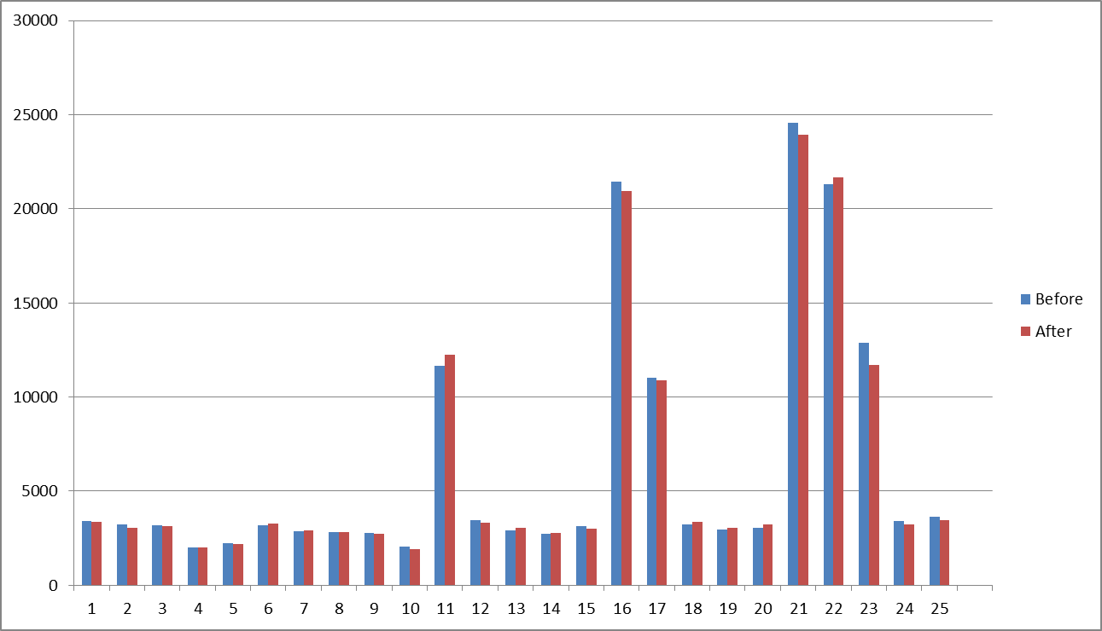
5_5x5_vm_local_regional_LHM_habitat Average Vector Population Before vs After
Before = Capacity – Count
After = Capacity

Slide 61
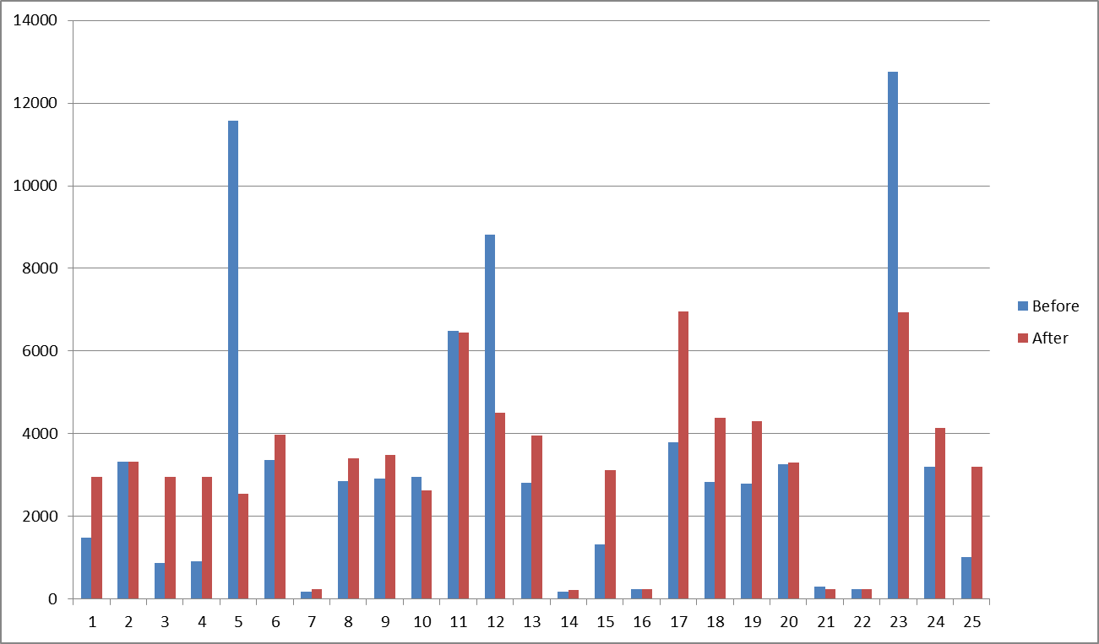
6_5x5_vm_local_regional_LHM_food Average Vector Population Before vs After

Slide 62
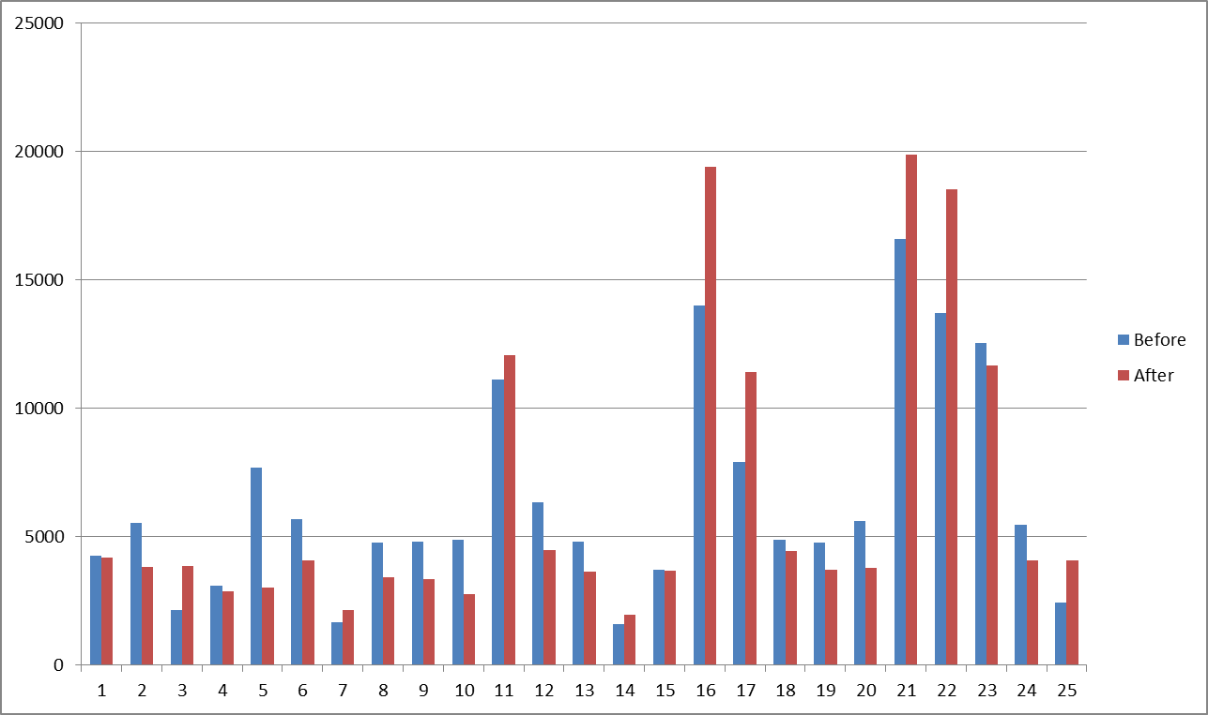
7_5x5_vm_local_regional_LHM_food_habitat Average Vector Population Before vs After

Slide 63
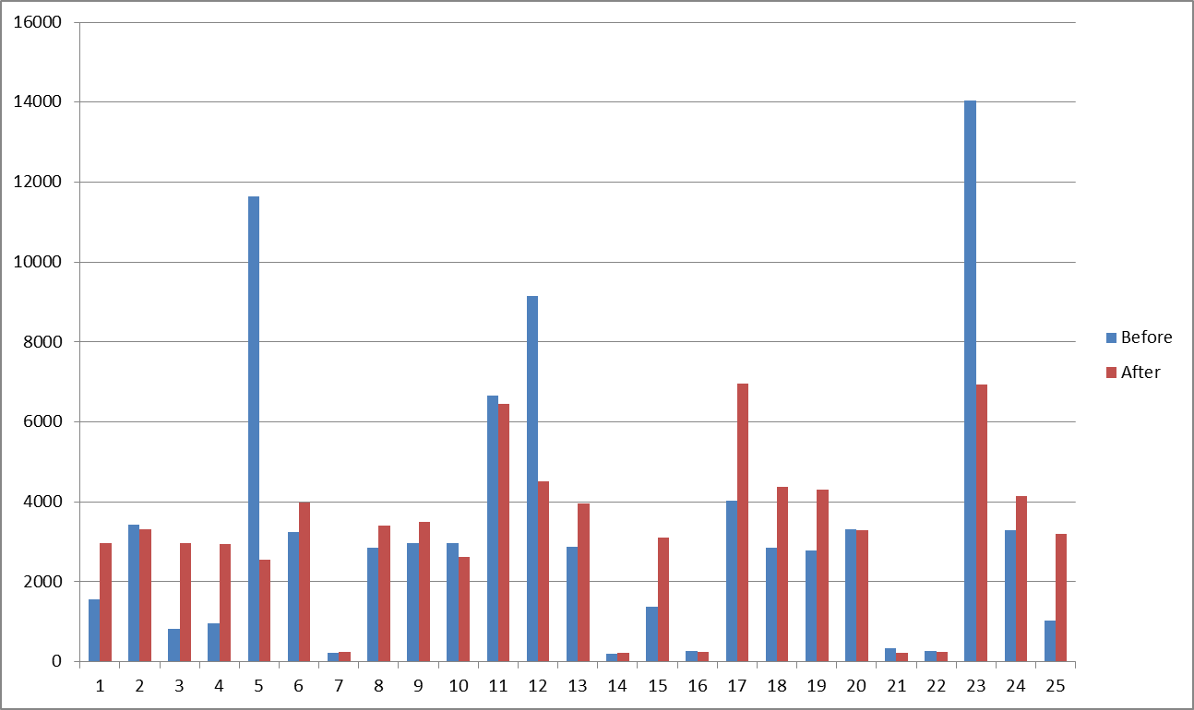
8_5x5_vm_local_regional_LHM_food_stay Average Vector Population Before vs After

Slide 64
Backup Slides

Slide 65
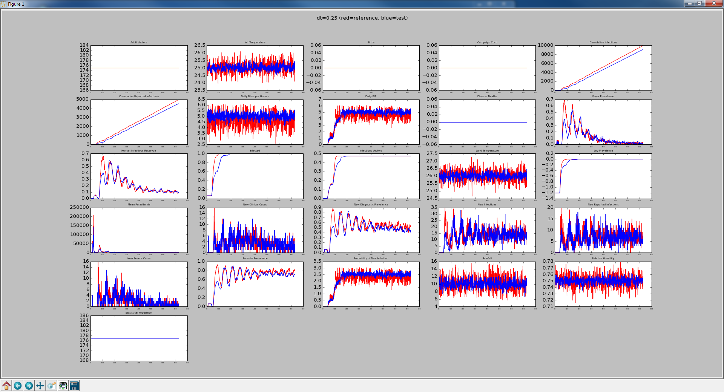
Comparison of DT= 1 vs DT = 0.25

Slide 66
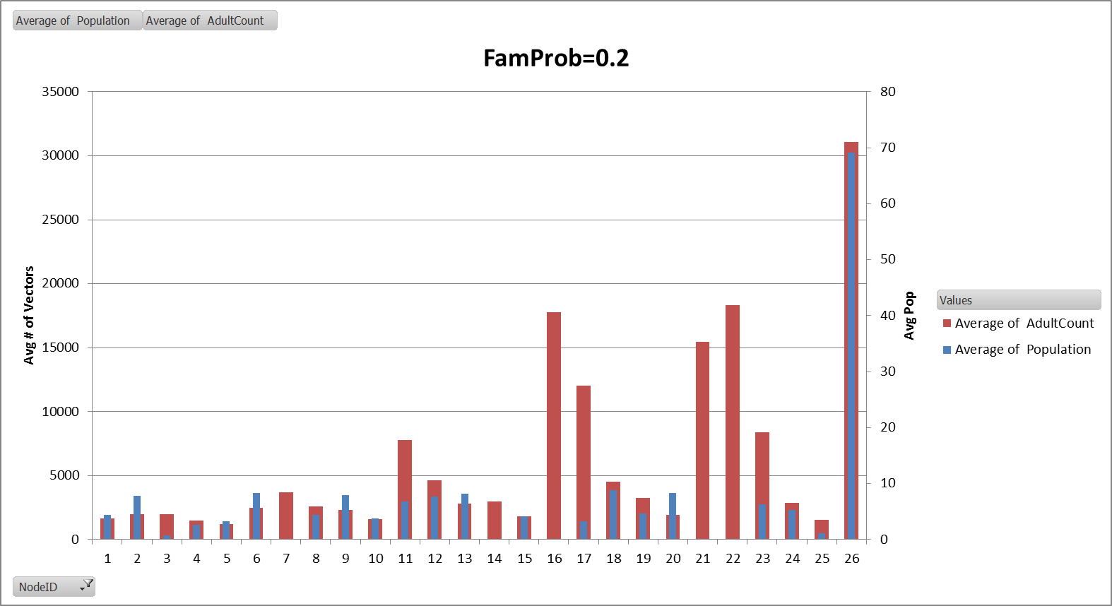

Slide 67
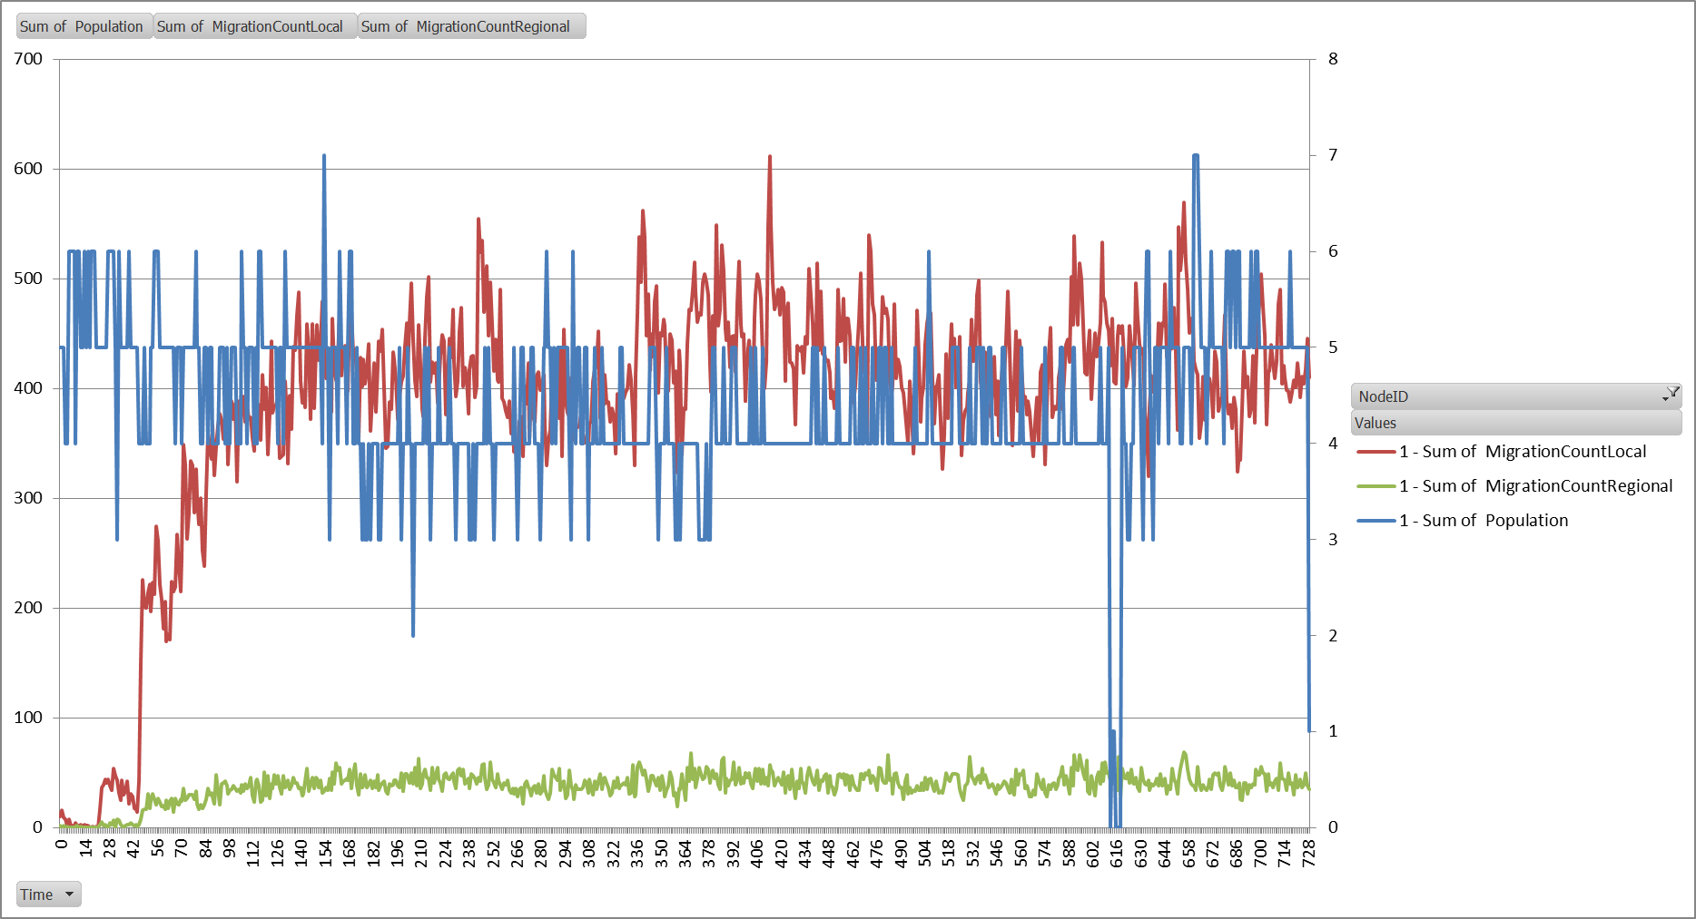

Slide 68
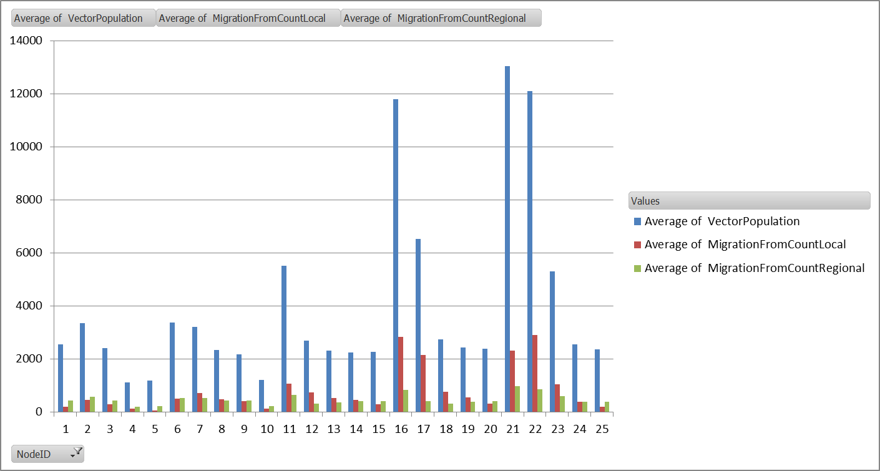
Local, Regional, LHM2, Habitat
LHM = 0.5, 1.0, 2.0, 4.0

Slide 69
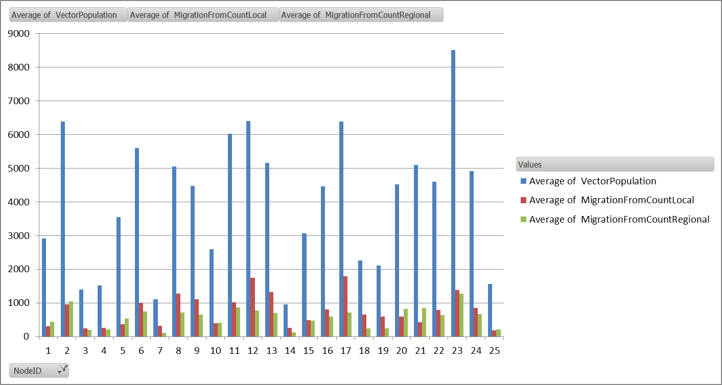
Local, Regional, LHM2, Habitat, Food
LHM = 0.5, 1.0, 2.0, 4.0

Slide 70
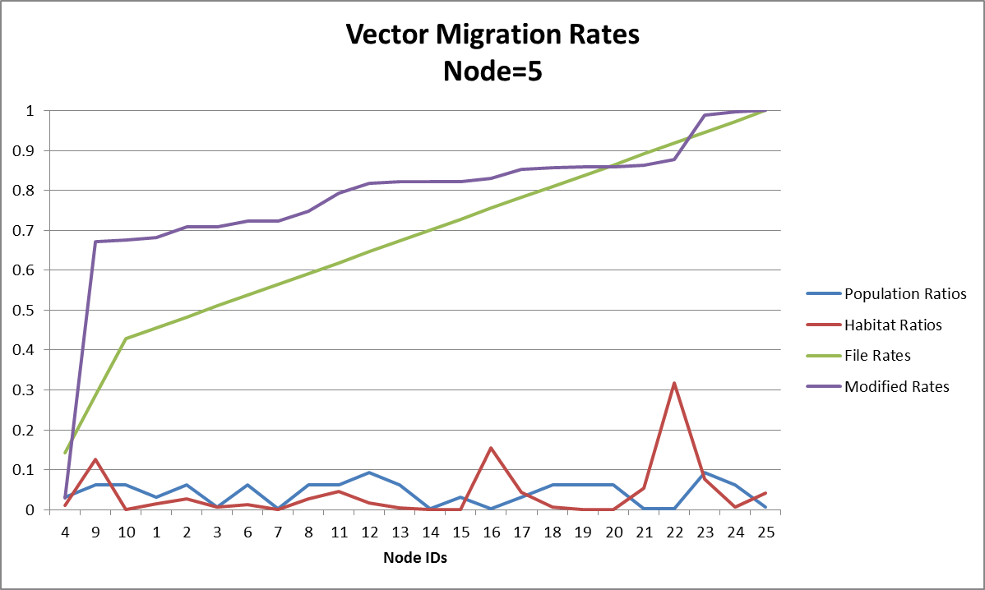
Gambiae
FM=1, HM=1
Multiplication

Slide 71
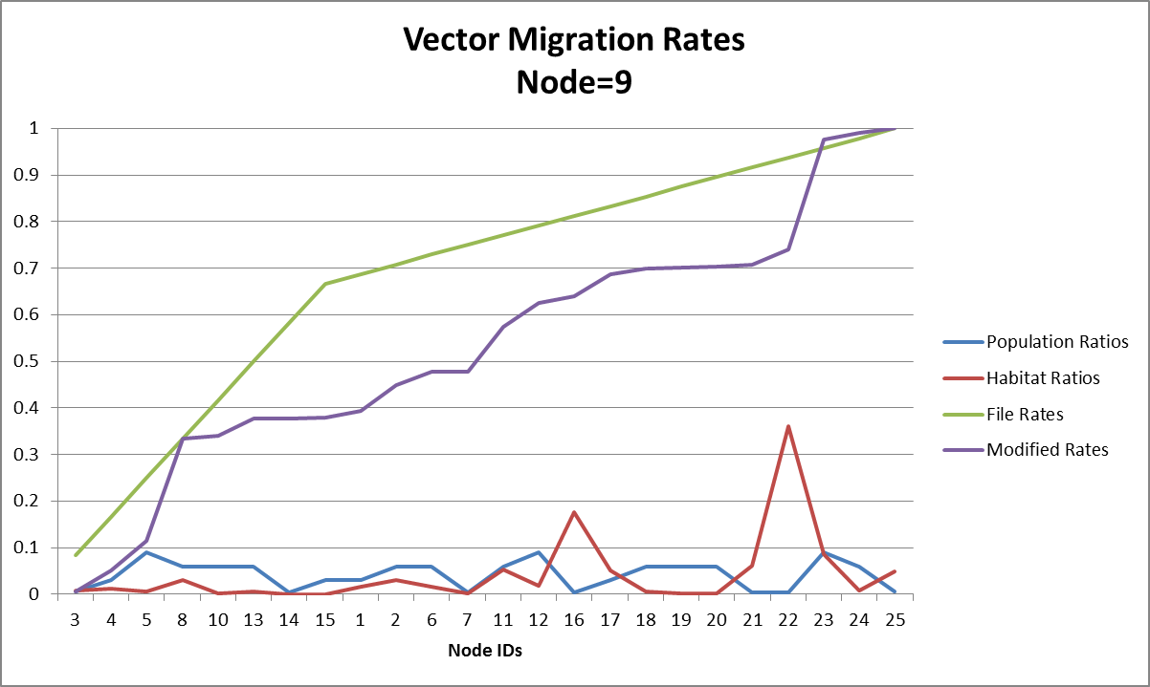
Gambiae
FM=1, HM=1
Multiplication

Slide 72
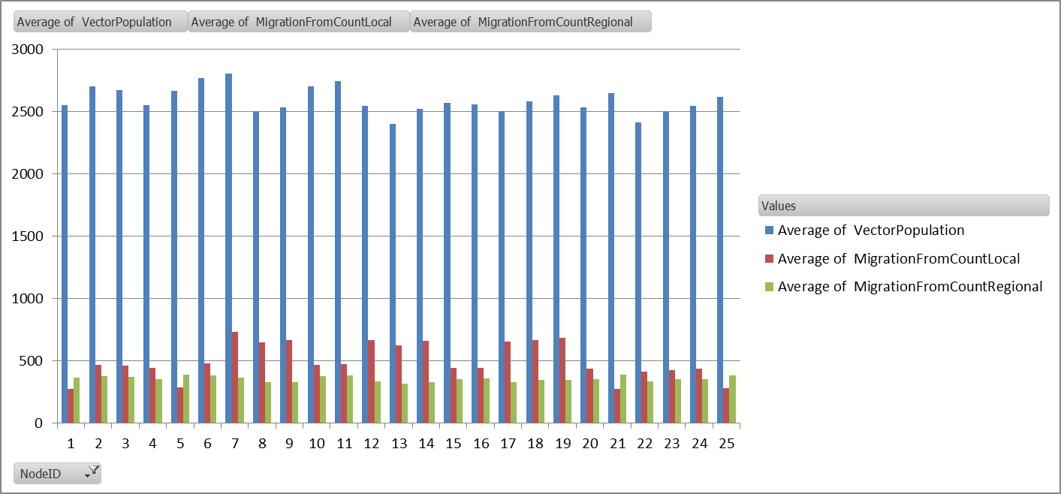
Habitat Modifier

Slide 73

Food Modifier

Slide 74

Food & Habitat Modifier

Slide 75

Food different run number

Slide 76

Vector Migration Comparison
"Enable_Vector_Migration_Local": 1,
"x_Vector_Migration_Local" : 1.0,
"Enable_Vector_Migration_Regional" : 1,
"x_Vector_Migration_Regional" : 1.0,
"Vector_Migration_Habitat_Modifier" : 0.0,
"Vector_Migration_Food_Modifier" : 1.0,
"Vector_Migration_Stay_Put_Modifier" : 0.0,
Local, Regional, LHM, Food
No Family Trips
Pop
0
Pop
0
Pop
0
Pop
15
Pop
15
Pop
15
Vary
Food
Pop
0
Pop
0

Slide 77

Vector Migration Comparison
"Enable_Vector_Migration_Local": 1,
"x_Vector_Migration_Local" : 1.0,
"Enable_Vector_Migration_Regional" : 1,
"x_Vector_Migration_Regional" : 1.0,
"Vector_Migration_Habitat_Modifier" : 0.0,
"Vector_Migration_Food_Modifier" : 1.0,
"Vector_Migration_Stay_Put_Modifier" : 0.0,
Local, Regional, LHM, Food
No Family Trips
Vary
Food
Human Population

